Slide 1
T
TRAINER SLIDES · IBF-STS ACCREDITED
Machine Learning 101 for Financial Trading
FSE-DAT-3019-1.1 · Data Analytics and Computational Modelling · Proficiency Level 3
Conducted by Tertiary Infotech Academy Pte Ltd · UEN 201200696W
Version 2.4 · 22 October 2026
© Tertiary Infotech Academy Pte Ltd. All rights reserved. · www.tertiarycourses.com.sg
Machine Learning 101 for Financial Trading · FSE-DAT-3019-1.1 · v2.4
© Tertiary Infotech Academy Pte Ltd
1

Slide 2
ATTENDANCE · IBF-STS
Attendance and IBF-STS Funding
Sign in every session
Mark attendance at the start of each session and after lunch.
75% attendance
IBF-STS funding requires at least 75% attendance.
1
%
Pass the assessment
Funding also requires passing both assessment components.
Assessment attendance
A separate record is signed before the assessment begins.
✓
!
Machine Learning 101 for Financial Trading · FSE-DAT-3019-1.1 · v2.4
© Tertiary Infotech Academy Pte Ltd
2

Slide 3
YOUR TRAINER · GENERAL
About the Trainer
NAME
____________________________________________
?
TITLE / DESIGNATION
____________________________________________
QUALIFICATIONS
____________________________________________
________________________
AREAS OF EXPERTISE
____________________________________________
Complete this panel with your own details before delivery.
TRAINING & INDUSTRY EXPERIENCE
____________________________________________
CONTACT
____________________________________________
Machine Learning 101 for Financial Trading · FSE-DAT-3019-1.1 · v2.4
© Tertiary Infotech Academy Pte Ltd
3

Slide 4
YOUR TRAINER
About the Trainer
ROLE
Course Developer, Trainer and Assessor
AA
CERTIFICATION
ACTA · DACE · PhD
FINANCIAL SERVICES
IBF-STS programmes in AI, algorithmic trading and fintech
Dr Alfred Ang
DELIVERS
AI, machine learning and data programmes for financial institutions
Course Developer · Trainer · Assessor for this IBF-STS programme.
FOUNDER
Tertiary Infotech Academy Pte Ltd
Machine Learning 101 for Financial Trading · FSE-DAT-3019-1.1 · v2.4
© Tertiary Infotech Academy Pte Ltd
4

Slide 5
ICE-BREAKER
Let's Know Each Other
• Your name, your institution and your role.
• Do you trade, invest, analyse or build systems for markets today?
• Have you used TradingView, a broker API or Python before?
• One trading rule you believe works — we will test it this week.
Machine Learning 101 for Financial Trading · FSE-DAT-3019-1.1 · v2.4
© Tertiary Infotech Academy Pte Ltd
5

Slide 6
HOUSEKEEPING
Ground Rules
Be on time
Sessions restart promptly after each break.
Phones on silent
Take calls outside the room.
⏱
📵
Ask as we go
Questions are welcome at any point.
Hands on the keyboard
Twenty labs — follow along on your own laptop.
?
⌨
Paper trading only
No real money is used anywhere in this course.
Not investment advice
Lion City Capital and all scenarios are fictitious.
📄
⚠
Machine Learning 101 for Financial Trading · FSE-DAT-3019-1.1 · v2.4
© Tertiary Infotech Academy Pte Ltd
6

Slide 7

COURSE PORTAL
Login to TMS and Download Course Material
Log in at lms-tms.tertiaryinfotech.com with your registered email + the OTP from your inbox, then download the slides, Learner Guide and labs.
Machine Learning 101 for Financial Trading · FSE-DAT-3019-1.1 · v2.4
© Tertiary Infotech Academy Pte Ltd
7

Slide 8
COURSE PORTAL · STEPS
Download Course Material
1
2
3
4
5
▶
▶
▶
▶
Go to lms-tms. tertiaryinfotech.com
Enter your registered email and click Send OTP
Key in the one-time password from your inbox
Open this course: download the Learner Slides + Learner Guide PDFs
Activities / Lab: download the labs folder (lab manuals)
Keep the Learner Guide open all course — the assessment is open book.
Machine Learning 101 for Financial Trading · FSE-DAT-3019-1.1 · v2.4
© Tertiary Infotech Academy Pte Ltd
8

Slide 9
COURSE PORTAL · GITHUB
Download the Labs and Simulator (GitHub)
Course repository
Trading simulator software
github.com/tertiarycourses/TGS-2023018794-Machine-Learning-101-for-Financial-Trading
Learner Guide, Learner Slides, Lesson Plan and the 20 lab instruction PDFs.
Code > Download ZIP.
github.com/alfredang/algorithmic-trader-bot
The quant / algo trading simulator the labs run in: backtest, forward test, paper trading, analytics.
Install steps: next section and the Learner Guide.
Machine Learning 101 for Financial Trading · FSE-DAT-3019-1.1 · v2.4
© Tertiary Infotech Academy Pte Ltd
9

Slide 10
LEARNING OUTCOMES
What You'll Achieve
1
LO1 · A1, A6
Develop hypotheses for implementing data analytics and computational modelling activities in algorithmic trading, and identify possible big data applications across the forms of data within financial services.
2
LO2 · A2, A3
Identify appropriate statistical algorithms and data models to test trading hypotheses, and use appropriate analytics platforms, analytical tools and statistical methods given specific analytics and reporting requirements.
3
LO3 · A4, A5
Conduct statistical modelling of market data with machine learning models to derive patterns and solutions, and perform A/B testing of trading strategies based on different hypotheses.
4
LO4 · A7, A8, A9, A10
Perform coding and configuration of an automated trading program based on selected models or algorithms, conduct tests on its actions and outcomes, diagnose unintended outcomes, and draw insights from the results to support decisions and report accordingly.
Machine Learning 101 for Financial Trading · FSE-DAT-3019-1.1 · v2.4
© Tertiary Infotech Academy Pte Ltd
10

Slide 11
COURSE JOURNEY
The Course Journey
1
Topic 1 — Quant and Algo Trading Foundations
Day 1 · Labs 1–4 · A1, A6, K1, K9 · Foundations of Quant and Algorithmic Trading: From Thorp to AI Agents
2
Topic 2 — Indicators, Strategies and Metrics
Day 1 · Labs 5–9 · A2, A3, K3, K5, K7 · Technical Indicators, Trading Strategies and Metrics with TradingView and Alpaca
3
Topic 3 — ML Models and A/B Testing
Day 2 · Labs 10–14 · A4, A5, K2, K4, K6 · Machine Learning Models, Statistical Modelling and A/B Testing for Trading Signals
4
Topic 4 — End-to-End Trading Pipeline
Day 2 · Labs 15–20 · A7, A8, A9, A10, K7, K8 · Building an End-to-End Algorithmic Trading Pipeline: Backtest, Forward Test and Performance Analysis
Machine Learning 101 for Financial Trading · FSE-DAT-3019-1.1 · v2.4
© Tertiary Infotech Academy Pte Ltd
11

Slide 12
THE PARADIGM SHIFT · HOW THIS COURSE WORKS
Low code. You own the algorithm.
This is a low-code course. Every lab runs in the Trading Simulator: you set the hypothesis, choose and configure the algorithm, run the tests and judge the results, while the software does the programming. What matters is the big concepts: the hypothesis, how each algorithm makes its decision, how it is tested without bias and with costs, how risk is controlled, and how the results are judged.
Machine Learning 101 for Financial Trading · FSE-DAT-3019-1.1 · v2.4
© Tertiary Infotech Academy Pte Ltd
12

Slide 13
THE PARADIGM SHIFT
Your Role versus the Software's Role
Your job: the hypothesis
What edge do you expect, why, and how will you know it is real?
Your job: the algorithm's logic
The rule or model, its inputs, and when it buys or sells.
1
2
Your job: testing and judgement
Out-of-sample, next-bar, net of costs; read the metrics.
Your job: risk and accountability
Limits, kill switch, approval - you answer for every trade.
3
4
The simulator's job: the code
It runs every stage - data, signals, backtests, paper orders and reports - from settings you choose.
The simulator's job: the drudgery
Data plumbing, charts, Pine Script export, reports - you review what it produces.
⚙
⚙
Machine Learning 101 for Financial Trading · FSE-DAT-3019-1.1 · v2.4
© Tertiary Infotech Academy Pte Ltd
13

Slide 14
FSE-DAT-3019-1.1 · ABILITIES 1-5
TSC Alignment — Abilities
1
A1
Develop hypotheses for implementing data analytics and computational modelling activities
2
A2
Identify appropriate statistical algorithms and data models to test hypotheses and/or theories
3
A3
Use appropriate analytics platforms, analytical tools, statistical methods and analytical approaches given specific analytics and reporting requirements
4
A4
Conduct statistical modelling of data to derive patterns and solutions
5
A5
Perform A/B testing based on different hypotheses
Machine Learning 101 for Financial Trading · FSE-DAT-3019-1.1 · v2.4
© Tertiary Infotech Academy Pte Ltd
14

Slide 15
FSE-DAT-3019-1.1 · ABILITIES 6-10
TSC Alignment — Abilities (continued)
1
A6
Identify possible big data applications
2
A7
Perform coding and configuration of software agents or programs based on selected models or algorithms
3
A8
Conduct tests on the actions taken and outcomes to assess effectiveness of the models
4
A9
Diagnose unintended outcomes produced by statistical models
5
A10
Draw relevant trends and insights from data analysis to support decisions and report accordingly
Machine Learning 101 for Financial Trading · FSE-DAT-3019-1.1 · v2.4
© Tertiary Infotech Academy Pte Ltd
15

Slide 16
FSE-DAT-3019-1.1 · KNOWLEDGE 1-5
TSC Alignment — Knowledge
1
K1
Data analytics and modelling business use cases
2
K2
Types of statistical analyses, data models, algorithms and advanced computational methods
3
K3
Range and application of various statistical methods and algorithms
4
K4
Range and application of various types of data models
5
K5
Usage of analytics platforms and tools
Machine Learning 101 for Financial Trading · FSE-DAT-3019-1.1 · v2.4
© Tertiary Infotech Academy Pte Ltd
16

Slide 17
FSE-DAT-3019-1.1 · KNOWLEDGE 6-9
TSC Alignment — Knowledge (continued)
1
K6
Statistical modelling techniques
2
K7
Coding languages for programming of algorithms and signals
3
K8
Potential reasons for unintended outcomes
4
K9
Forms of data within financial services
Machine Learning 101 for Financial Trading · FSE-DAT-3019-1.1 · v2.4
© Tertiary Infotech Academy Pte Ltd
17

Slide 18
COURSE SCHEDULE
Lesson Plan — Day 1 (1 of 2)
09:00 - 18:30 · 8 instructional hours · excluding 1-hour lunch and two tea breaks
09:00 - 09:30
Course Overview, Trainer Introduction and Ground Rules
09:30 - 10:45
T1.1-1.4 Quant Success Stories, the Evolution of Quant, the ML-to-LLM Shift, and Agentic AI versus AI Agents
K1, K9
10:45 - 11:00 Tea Break
11:00 - 11:30
T1.5-1.6 Forms of Financial Data, Big Data Applications and Trading Hypotheses
A1, A6, K1, K9
11:30 - 11:50
Lab 1: Pipeline Skeleton, Configuration and the Alpaca Paper Account
K5
11:50 - 12:10
Lab 2: Data-Validation Stage: Cross-Check Pipeline Bars against TradingView
A3, K5, K9
12:10 - 12:30
Lab 3: Ingestion Stage: Multi-Timeframe Bars, Headlines and Data Quality
A6, K9
12:30 - 13:30 Lunch Break
13:30 - 13:45
Lab 4: Hypothesis Stage: from a Written Card to an Automated Statistical Test
A1, A6, K1
13:45 - 14:30
T2.1-2.2 Technical Indicators and Standard Algorithmic Trading Strategies
A2, K3
Machine Learning 101 for Financial Trading · FSE-DAT-3019-1.1 · v2.4
© Tertiary Infotech Academy Pte Ltd
18

Slide 19
COURSE SCHEDULE
Lesson Plan — Day 1 (2 of 2)
09:00 - 18:30 · 8 instructional hours · excluding 1-hour lunch and two tea breaks
14:30 - 14:55
Lab 5: Indicator Stage: Pine Script v6 Indicators and their Python Twins
A3, K3, K7
14:55 - 15:25
Lab 6: Strategy Prototype: TradingView Strategy Tester, Paper Trading from the Chart and Pipeline Reconciliation
A2, A3, K3, K7
15:25 - 15:40 Tea Break
15:40 - 16:05
Lab 7: Signal Stage: a Library of Trend, Mean-Reversion, Momentum and Breakout Signals
A2, K3, K7
16:05 - 16:50
T2.3-2.4 Analytics Platforms, Coding Languages and Order Placement
A3, K5, K7
16:50 - 17:20
Lab 8: Execution Stage: an Order Manager that Trades the Paper Account in Any Session
A3, K5
17:20 - 17:50
T2.5 Performance and Risk Metric Definitions
A3, K3
17:50 - 18:15
Lab 9: Evaluation Stage: Performance and Risk Metrics with a Benchmark Table
A3, K3
18:15 - 18:30
Day 1 Recap and Q&A
Machine Learning 101 for Financial Trading · FSE-DAT-3019-1.1 · v2.4
© Tertiary Infotech Academy Pte Ltd
19

Slide 20
COURSE SCHEDULE
Lesson Plan — Day 2 (1 of 2)
09:00 - 18:30 · 8 instructional hours · excluding 1-hour lunch and two tea breaks
09:00 - 09:15
Day 1 Recap and Day 2 Overview
09:15 - 09:40
T3.1-3.2 Statistical Analyses, Algorithms and Supervised Learning Models
A4, K2, K4
09:40 - 10:00
Lab 10: Strategy-Search Stage: Grid Search, Out-of-Sample Ranking and Decay
A2, A4, K2
10:00 - 10:20
Lab 11: ML-Signal Stage: a Walk-Forward Classifier from Probability to Position
A4, K4, K6
10:20 - 10:35 Tea Break
10:35 - 10:55
T3.3-3.4 Unsupervised Learning and Statistical Modelling Techniques
A4, K4, K6
10:55 - 11:10
Lab 12: Regime-Filter Stage: PCA and K-Means as a Gate on the Signals
A4, K4, K6
11:10 - 11:25
T3.5-3.6 A/B Testing, and Pairs Trading as a Hedging Algorithm
A4, A5, K2, K6
11:25 - 11:40
Lab 13: A/B-Test Stage: a Statistical Decision before Capital Moves
A5, K2
11:40 - 12:00
Lab 14: Pairs Stage: a Hedged, Market-Neutral Statistical-Arbitrage Sleeve
A4, K6
12:00 - 12:30
T4.1-4.2 Pipeline Architecture and Backtesting with Trading Costs
A7, A8, K7
12:30 - 13:30 Lunch Break
Machine Learning 101 for Financial Trading · FSE-DAT-3019-1.1 · v2.4
© Tertiary Infotech Academy Pte Ltd
20

Slide 21
COURSE SCHEDULE
Lesson Plan — Day 2 (2 of 2)
09:00 - 18:30 · 8 instructional hours · excluding 1-hour lunch and two tea breaks
13:30 - 13:55
Lab 15: Backtest-Engine Stage: Cost Models, Execution Timing and Break-Even
A7, A8, K7
13:55 - 14:05
T4.3 Forward Testing with Automated Paper Trading
A7, A8
14:05 - 14:30
Lab 16: Automation Stage: a Scheduled, Risk-Checked Forward Test and Live Paper Trading
A7, A8, K7
14:30 - 14:50
Lab 17: Event-Driven Automation: TradingView Webhook to Signal, Risk and Execution
A7, K5, K7
14:50 - 15:00
T4.4 Potential Reasons for Unintended Outcomes
A9, K8
15:00 - 15:20
Lab 18: Diagnostics Stage: Automated Bias Checks before Go-Live
A9, K8
15:20 - 15:35 Tea Break
15:35 - 15:45
T4.5 Performance Analysis, Insights and Reporting
A10
15:45 - 16:10
Lab 19: Monitoring and Reporting Stage: Automated Tearsheet and Backtest-vs-Forward Report
A8, A10
16:10 - 16:30
Lab 20: Capstone: One Command Runs the Pipeline End to End, with an Agentic Layer and Human Approval
A7, A10, K1
16:30 - 17:15
Written Assessment (Short Answer Questions)
K1 - K9
17:15 - 18:30
Practical Performance Assessment
A1 - A10
Machine Learning 101 for Financial Trading · FSE-DAT-3019-1.1 · v2.4
© Tertiary Infotech Academy Pte Ltd
21

Slide 22
BEFORE THE ASSESSMENT
Briefing for Assessment
Open book
You may use your Learner Guide, lab manuals and your own notes.
Two components
Written Assessment (45 min) and Practical Performance (75 min).
📖
2
Both must be passed
Competent in BOTH is required to be awarded the module.
All your own work
Collaboration results in a Not Yet Competent outcome.
✓
👤
Ask if unclear
The assessor can explain a question, but not how to answer it.
Not Yet Competent?
You will be counselled on the gaps and offered a re-assessment.
?
↻
Machine Learning 101 for Financial Trading · FSE-DAT-3019-1.1 · v2.4
© Tertiary Infotech Academy Pte Ltd
22

Slide 23
FINAL ASSESSMENT
Final Assessment
Written Assessment
Practical Performance
Short Answer Questions · 45 minutes · open book.
9 open-ended questions — one for each knowledge statement K1 - K9.
No multiple-choice questions.
Configure and run the provided trading program - no coding · 75 minutes · open book.
4 practical tasks covering ability statements A1 - A10.
A new trading scenario, using the same pipeline tool-kit as the labs.
Machine Learning 101 for Financial Trading · FSE-DAT-3019-1.1 · v2.4
© Tertiary Infotech Academy Pte Ltd
23

Slide 24
ON ASSESSMENT DAY
Assessment Flow
1
2
3
4
5
▶
▶
▶
▶
Sign the assessment attendance record
Assessor briefing (not assessed)
Sit the WA (45 min) then the PP (75 min) — open book
Submit your answers on the LMS
Sign the Assessment Summary Record
Both components are open book. You must be Competent in BOTH to be awarded the module.
Machine Learning 101 for Financial Trading · FSE-DAT-3019-1.1 · v2.4
© Tertiary Infotech Academy Pte Ltd
24

Slide 25
01
GETTING STARTED
Set Up Alpaca and TradingView
LEARNING OUTCOME
Install the Trading Simulator and create the free accounts every lab uses. Everything runs on paper — no real money at any point.
Machine Learning 101 for Financial Trading · FSE-DAT-3019-1.1 · v2.4
© Tertiary Infotech Academy Pte Ltd
25

Slide 26
GETTING STARTED
Download, Install and Start the Trading Simulator Software
Full step-by-step guide: Learner Guide, 'Platform Guides'.
1
2
3
4
5
6
▶
▶
▶
▶
▶
Install Docker Desktop - or Python 3.11+ and uv
Download the simulator: GitHub > Code > Download ZIP
Start it: docker compose up -d (or uv sync, then uv run trader serve --with-worker)
Load the demo data: Settings > Load demo data
Open http://localhost:8000 > Course Labs
Keys: Integrations page (no files to edit)
Simulator: github.com/alfredang/algorithmic-trader-bot - the README has the full start-up steps and troubleshooting.
Machine Learning 101 for Financial Trading · FSE-DAT-3019-1.1 · v2.4
© Tertiary Infotech Academy Pte Ltd
26

Slide 27
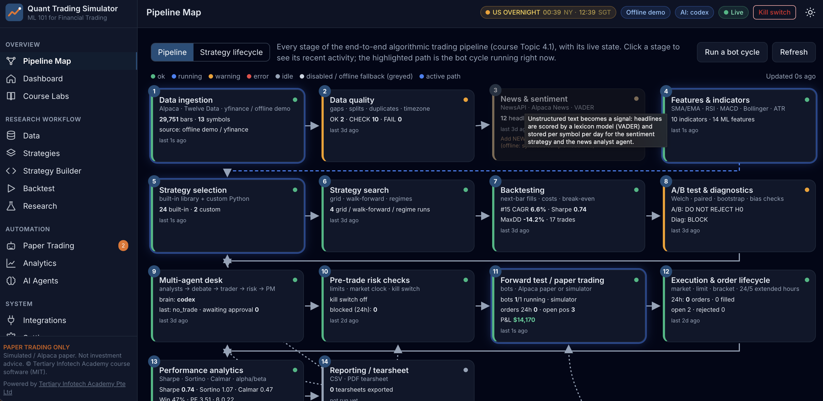
GETTING STARTED
The Trading Simulator — Pipeline Map
Once the simulator is running, Pipeline Map shows every stage of the automated pipeline and its live state. Click a stage to see its most recent activity.
Machine Learning 101 for Financial Trading · FSE-DAT-3019-1.1 · v2.4
© Tertiary Infotech Academy Pte Ltd
27

Slide 28
GETTING STARTED
Sign Up for Alpaca and Open the Paper-Trading Account
Full step-by-step guide: Learner Guide, 'Platform Guides'.
1
2
3
4
5
▶
▶
▶
▶
Sign up at alpaca.markets and verify your email
Log in; choose 'Paper Trading' (upper left)
API section: generate key - copy the secret once
Simulator: Integrations > Alpaca > paste > Save & test
Test connection: 'Paper account ACTIVE'
No funding needed. Paper keys only work on paper-api.alpaca.markets. No account? Every lab also runs offline.
Machine Learning 101 for Financial Trading · FSE-DAT-3019-1.1 · v2.4
© Tertiary Infotech Academy Pte Ltd
28

Slide 29

GETTING STARTED
Your Alpaca Paper-Trading Dashboard
Check that the account selector shows 'Paper'. The banner confirms that no real money is being used. The API keys for the labs are generated from this account.
Machine Learning 101 for Financial Trading · FSE-DAT-3019-1.1 · v2.4
© Tertiary Infotech Academy Pte Ltd
29

Slide 30

GETTING STARTED
Connect Alpaca to the Simulator — Integrations
Paste the paper Key ID and Secret into the Alpaca card, then press Save & test. Keys stay on your computer and are only shown masked. Without keys, every lab still runs offline.
Machine Learning 101 for Financial Trading · FSE-DAT-3019-1.1 · v2.4
© Tertiary Infotech Academy Pte Ltd
30

Slide 31
GETTING STARTED
Sign Up for TradingView and Find the Tools You Will Use
Full step-by-step guide: Learner Guide, 'Platform Guides'.
1
2
3
4
5
▶
▶
▶
▶
Sign up at tradingview.com (email, Google or Apple)
Keep the free plan
Products > Supercharts; search NASDAQ:AAPL or SGX:D05
Set time zone to Singapore
Find Indicators, Pine Editor, Strategy Tester, Trade
The free plan covers Labs 2, 5 and 6. Webhook alerts in Lab 17 need a paid plan - the lab includes a local simulator.
Machine Learning 101 for Financial Trading · FSE-DAT-3019-1.1 · v2.4
© Tertiary Infotech Academy Pte Ltd
31

Slide 32

GETTING STARTED
TradingView — Chart, Watchlist and Symbol Panel
Search for a symbol, pick the interval, and add Indicators. Pine Script and the Strategy Tester open from the panel below the chart, and Trade opens Paper Trading.
Machine Learning 101 for Financial Trading · FSE-DAT-3019-1.1 · v2.4
© Tertiary Infotech Academy Pte Ltd
32

Slide 33
GETTING STARTED · LOW CODE
No Coding Needed - and a Prompt Library if You Want the Code
Every lab, no code
Want to see the code?
Run it without installing
Each lab runs in the Trading Simulator: choose settings, press Run, read the result. The lab manual gives every step and check.
labs_lowcode/Prompt_Library.html has one prompt per lab. One click opens Claude or ChatGPT with the prompt filled in - the AI writes the code for you.
Paste the code into Google Colab and press Run, or paste a strategy into the simulator's Strategy Builder. Never paste API keys into an AI chat.
Machine Learning 101 for Financial Trading · FSE-DAT-3019-1.1 · v2.4
© Tertiary Infotech Academy Pte Ltd
33

Slide 34
PLATFORM · THE IDEA THAT MATTERS MOST
Paper first. Always.
Every strategy in this course is tested on history, then forward-tested on a paper account with automatic orders, before anyone would consider real capital. That discipline is the course.
Machine Learning 101 for Financial Trading · FSE-DAT-3019-1.1 · v2.4
© Tertiary Infotech Academy Pte Ltd
34

Slide 35
01
TOPIC 1
Quant and Algo Trading Foundations
LEARNING OUTCOME
Develop hypotheses for implementing data analytics and computational modelling activities in algorithmic trading, and identify possible big data applications across the forms of data within financial services.
Abilities A1, A6 · Knowledge K1, K9 · Day 1 · Labs 1–4 · Assessed by PP Task 1 and WA Q1, Q9
Machine Learning 101 for Financial Trading · FSE-DAT-3019-1.1 · v2.4
© Tertiary Infotech Academy Pte Ltd
35

Slide 36
TOPIC 1 · K1 · QUANT SUCCESS STORIES
K1
Quant Success Stories
Ed Thorp - Princeton Newport · 1969
First market-neutral quant fund: about 20% a year after fees for two decades by hedging warrants and convertibles
Renaissance - Medallion · 1988
Purely model-driven; about 66% a year before fees, 39% after (1988-2018); closed to outsiders, employee-owned
1
2
D.E. Shaw · 1988
Founded by a computer-science professor from Morgan Stanley's quant group; models and software; about US$60-65bn
Man AHL · 1987
Systematic trend following from hand-typed price histories to momentum models across 800+ markets
3
4
Two Sigma · 2001
AI, machine learning and distributed computing applied to trading; about US$70bn under management
Jane Street · 2024
Quant market maker: about US$20.5bn net trading revenue; nearly a quarter of primary US ETF activity
5
6
Machine Learning 101 for Financial Trading · FSE-DAT-3019-1.1 · v2.4
© Tertiary Infotech Academy Pte Ltd
36

Slide 37
TOPIC 1 · K1 · QUANT SUCCESS STORIES
K1
Spotlight: Renaissance Technologies and the Medallion Fund
Founded by a mathematician
Jim Simons founds Monemetrics in 1978; renamed Renaissance Technologies in 1982
Medallion fund, 1988
The flagship fund trades purely on mathematical models of market data
1
2
About 66% a year before fees
Average gross return 1988-2018, about 39% after its high fees; closed to outsiders, employee-owned
The lesson for this course
The edge came from data, rigorous testing, costs and risk control - not from one clever indicator
3
4
Machine Learning 101 for Financial Trading · FSE-DAT-3019-1.1 · v2.4
© Tertiary Infotech Academy Pte Ltd
37

Slide 38
TOPIC 1 · K1 · QUANT SUCCESS STORIES
K1
What the Success Stories Have in Common
1
Hypothesis first
Each started from a testable idea about prices, not from a tool
2
Data and testing
Clean data and out-of-sample tests before capital
3
Many small edges
Diversified, market-neutral bets rather than one big call
4
Costs and risk
Execution cost, leverage and risk limits decide survival - see LTCM 1998
5
Citadel Securities
Quant market maker estimated to handle about a quarter of all US equities trading
Machine Learning 101 for Financial Trading · FSE-DAT-3019-1.1 · v2.4
© Tertiary Infotech Academy Pte Ltd
38

Slide 39
TOPIC 1 · DEFINITION
Algorithmic trading
Using computer programs that follow predefined rules on price, timing, volume or models to generate and execute orders automatically, with limited or no human intervention.
Machine Learning 101 for Financial Trading · FSE-DAT-3019-1.1 · v2.4
© Tertiary Infotech Academy Pte Ltd
39

Slide 40
TOPIC 1 · K1 · EVOLUTION OF QUANT
K1
The Evolution of Quant: From Thorp to HFT to AI
1
2
3
4
5
6
7
▶
▶
▶
▶
▶
▶
1950s-70s: portfolio theory, arbitrage and option pricing
1970s-80s: factor risk models and program trading
1980s-90s: statistical arbitrage and pairs trading
1988 on: fully systematic signal mining (Renaissance, D.E. Shaw)
2000s: electronic market making and HFT
2010s: speed race - co-location, microwave, microseconds
2020s: ML on alternative data, then LLM and agentic quant
Each era kept the last era's discipline - hypothesis, data, testing, costs, risk - and added speed or new data.
Machine Learning 101 for Financial Trading · FSE-DAT-3019-1.1 · v2.4
© Tertiary Infotech Academy Pte Ltd
40

Slide 41
TOPIC 1 · K1 · HISTORY OF QUANT
K1
The Evolution of Quant and Algorithmic Trading (1 of 4)
1952
Modern portfolio theory
Markowitz's 'Portfolio Selection' measures risk as variance: diversification becomes maths
1969
First market-neutral quant fund
Thorp's fund (Princeton Newport from 1974) earns about 20% a year after fees for two decades
Mid-1970s
Factor risk models
Barr Rosenberg's Barra models portfolio risk from style, industry and size factors
1967
Thorp's 'Beat the Market'
Ed Thorp applies probability to hedging warrants - an early quant trading playbook
1973
Black-Scholes and the CBOE
Option-pricing formula published as the CBOE opens (Apr 1973); CBOE adopts it by 1975
1978
Renaissance is founded
Mathematician Jim Simons founds Monemetrics; renamed Renaissance Technologies in 1982
Machine Learning 101 for Financial Trading · FSE-DAT-3019-1.1 · v2.4
© Tertiary Infotech Academy Pte Ltd
41

Slide 42
TOPIC 1 · K1 · HISTORY OF QUANT
K1
The Evolution of Quant and Algorithmic Trading (2 of 4)
1980s
Statistical arbitrage
Bamberger and Tartaglia's Morgan Stanley group trades pairs of co-moving stocks by rule
1988
Medallion and D.E. Shaw
Renaissance launches Medallion; ex-Morgan Stanley quant David Shaw founds D.E. Shaw
1998
LTCM collapses
Leveraged relative-value fund loses US$4.6bn; Fed-supervised US$3.65bn recapitalisation
1987
Black Monday
Dow falls 22.6% on 19 Oct; portfolio-insurance program selling deepens the crash
1996
Island ECN
Fast electronic order book (trading from 1997) becomes a hub for early HFT firms
2001
Decimalisation
US stocks quote in cents, not 1/16ths; spreads narrow and electronic market making grows
Machine Learning 101 for Financial Trading · FSE-DAT-3019-1.1 · v2.4
© Tertiary Infotech Academy Pte Ltd
42

Slide 43
TOPIC 1 · K1 · HISTORY OF QUANT
K1
The Evolution of Quant and Algorithmic Trading (3 of 4)
2005
Regulation NMS
SEC rule (in force 2007) links venues; fragmentation rewards speed and smart order routing
2010
Flash Crash
6 May: the Dow drops nearly 1,000 points in minutes after a large algorithmic sell order
2012
Knight Capital
A faulty deployment sends millions of orders in 45 minutes; Knight loses over US$460m
2007
The quant quake
Week of 6 Aug: crowded quant market-neutral funds suffer sudden losses as positions unwind
2010
The speed race
US$300m straight fibre New York-Chicago cuts about 3 ms; microwave links soon beat it
2016
IEX speed bump
SEC approves IEX as an exchange with a 350-microsecond delay against latency arbitrage
Machine Learning 101 for Financial Trading · FSE-DAT-3019-1.1 · v2.4
© Tertiary Infotech Academy Pte Ltd
43

Slide 44
TOPIC 1 · K1 · HISTORY OF QUANT
K1
The Evolution of Quant and Algorithmic Trading (4 of 4)
2018
MiFID II
EU requires algorithm testing, kill switches and records; HFT formally defined
2020
SGX RegCo algo guide
Sets expectations for governance, risk controls and testing of algorithms by SGX members
2024
Multi-agent LLM trading
TradingAgents (Dec 2024): analyst, debate, trader and risk agents trade stocks
2018
API-first brokers
Alpaca's commission-free trading API opens algorithmic stock trading to individuals
2023
LLM trading signals
ChatGPT headline sentiment predicts next-day stock returns (Lopez-Lira and Tang)
2026
MAS AI Risk Management
Guidelines issued 7 Oct 2026, effective 7 Oct 2027: AI inventories and lifecycle controls
Machine Learning 101 for Financial Trading · FSE-DAT-3019-1.1 · v2.4
© Tertiary Infotech Academy Pte Ltd
44

Slide 45
TOPIC 1 · K1 · PARADIGM SHIFTS
K1
Six Paradigm Shifts in Quant and Algorithmic Trading
From intuition to probability · 1950s-1970s
Markowitz, Thorp and Black-Scholes make risk, hedging and option value mathematical
From stocks to factors · 1970s-1980s
Barra factor models and program trading treat portfolios as baskets of risk exposures
1
2
From factors to statistical arbitrage · 1980s-2000s
Morgan Stanley's pairs group, D.E. Shaw and Renaissance harvest many small market-neutral edges
From floors to electronic speed · 1996-2010s
ECNs, decimalisation and Reg NMS enable HFT: co-location, microwave links, microseconds
3
4
From statistics to machine learning · 2000s-2010s
Models learn non-linear patterns from prices, order books and alternative data
From writing code to directing AI · 2023-present
AI writes and runs the code; quants own the big concepts - hypothesis, algorithm logic, testing, risk
5
6
Machine Learning 101 for Financial Trading · FSE-DAT-3019-1.1 · v2.4
© Tertiary Infotech Academy Pte Ltd
45

Slide 46
TOPIC 1 · K1
Why Algorithms - and What Can Go Wrong
Benefits
Risks
• Speed: reacts and executes in milliseconds
• Discipline: rules remove fear, greed and fatigue
• Backtesting: test ideas on historical data first
• Lower costs: split large orders to reduce market impact
• Scale: monitors many markets and assets around the clock
• Technical failure: bugs and outages (Knight Capital, 2012)
• Overfitting: great backtests that fail on live data
• Black swans and regime change the model has never seen
• Feedback loops between algorithms (2010 Flash Crash)
• Set-up, data and compliance costs; no guaranteed profit
Machine Learning 101 for Financial Trading · FSE-DAT-3019-1.1 · v2.4
© Tertiary Infotech Academy Pte Ltd
46

Slide 47
TOPIC 1 · K1 · AI IN TRADING
K1
The Eras of AI in Trading
1
Symbolic AI · 1956-1980s
Hand-written rules: expert systems and rule-based program trading; brittle when markets change
2
Machine learning · 1990s-2000s
Models learn from data: regression, tree and boosting signals; statistical arbitrage at scale
3
Deep learning · 2012-2017
Many-layer networks on GPUs find non-linear patterns in prices, order books and alternative data
4
Generative AI · 2017-2023
Transformers and LLMs turn news, filings and earnings calls into trading signals
5
Agentic AI · 2024-present
LLM agents research, code, backtest and paper-trade strategies under hard risk limits
Machine Learning 101 for Financial Trading · FSE-DAT-3019-1.1 · v2.4
© Tertiary Infotech Academy Pte Ltd
47

Slide 48
TOPIC 1 · K1 · AI IN TRADING
K1
AI Milestones and Their Trading Counterparts (1 of 2)
1950
Turing Test
Turing asks if machines can think; in 1952 Markowitz turns portfolio choice into maths
1980s
Expert systems
Hand-written if-then rules - the same logic as the rule-based program trading of the 1980s
1988
Models trade markets
Renaissance's Medallion fund launches, trading purely on mathematical models of market data
2012
Deep learning
GPU-trained deep networks win ImageNet; deep learning becomes a new tool for market data
1956
'AI' is named
AI becomes a field; Ed Thorp soon applies computers and probability to blackjack, then markets
1986
Backpropagation
Multi-layer neural networks become trainable - the ancestor of today's price-prediction nets
1997
Deep Blue
IBM beats Kasparov at chess; computer-driven quant firms such as D.E. Shaw are already trading
Machine Learning 101 for Financial Trading · FSE-DAT-3019-1.1 · v2.4
© Tertiary Infotech Academy Pte Ltd
48

Slide 49
TOPIC 1 · K1 · AI IN TRADING
K1
AI Milestones and Their Trading Counterparts (2 of 2)
2016
AlphaGo
Deep reinforcement learning wins at Go; RL is researched for order execution and portfolios
2023
LLMs meet markets
BloombergGPT (50bn parameters); ChatGPT headline sentiment predicts next-day stock returns
2025
Agentic quant research
LLM agents mine formulaic alphas and write backtests (e.g. Alpha-GPT, AlphaAgent)
2026
Governed AI
MAS AI Risk Management Guidelines (7 Oct 2026) set lifecycle controls for AI in finance
2017
Transformer
The architecture behind every LLM - later used to read news and filings for trading signals
2024
Multi-agent trading
TradingAgents models a trading firm: analyst, bull/bear debate, trader and risk agents
2026
Always-on AI agents
OpenClaw, Hermes Agent and OpenAI Dots stand by 24/7: agentic AI that keeps working
Machine Learning 101 for Financial Trading · FSE-DAT-3019-1.1 · v2.4
© Tertiary Infotech Academy Pte Ltd
49

Slide 50
TOPIC 1 · K1, K9 · ML TO LLM
K1 K9
Paradigm Shift: Machine-Learning Quant versus LLM-Era Quant
Machine-learning quant
LLM-era quant
Main data
Structured: prices, volumes, fundamentals
Adds unstructured text: news, filings, earnings calls, research
Features
Hand-engineered by the quant (lags, RSI, factors)
Text read directly; LLM scores sentiment and events
Model building
Fit regressions, trees, boosting on labelled data
Prompt or fine-tune pretrained LLMs; agents propose alphas
Who writes the code
The quant, line by line
AI writes it; the quant directs and reviews
Research workflow
The quant writes every line of code
Coding agents draft code and backtests; the quant reviews
Alpha decay
Signals fade as more funds trade them
LLM signals fade too as LLM adoption rises
New risks
Overfitting; look-ahead in features
LLM training-data look-ahead and 'distraction'; homogeneous factors
Human role
Model builder
Supervisor: hypothesis, testing, risk sign-off
Machine Learning 101 for Financial Trading · FSE-DAT-3019-1.1 · v2.4
© Tertiary Infotech Academy Pte Ltd
50

Slide 51
TOPIC 1 · K1, K9 · ML TO LLM
K1 K9
Impact of LLMs on Quant
Text becomes a signal
ChatGPT headline scores predict next-day returns, strongest for small stocks and bad news (Lopez-Lira and Tang)
Finance-specific LLMs
BloombergGPT (2023): 50bn parameters trained with 363bn tokens of Bloomberg financial data
1
2
Automated alpha mining
Alpha-GPT turns ideas into formulaic alphas; AlphaAgent targets alpha decay and crowding
Backtests need new controls
LLMs may 'know' in-sample history: test after the knowledge cutoff and anonymise firms (Glasserman and Lin)
3
4
Faster crowding
Strategy returns decline as LLM adoption rises - prices become more efficient (Lopez-Lira and Tang)
Agents still need limits
Agents propose trades; hard-coded risk checks and humans approve them
5
6
Machine Learning 101 for Financial Trading · FSE-DAT-3019-1.1 · v2.4
© Tertiary Infotech Academy Pte Ltd
51

Slide 52
TOPIC 1 · K1 · AGENTIC AI
Agentic AI versus AI Agents in Trading
Agentic AI - the capability
AI Agent - always on, 24/7
The capability of AI to plan and act: it calls tools, uses skills and memory, and follows instructions to complete multi-step work when it is asked.
Trading example: On request, an LLM fetches a stock's bars and news through tools, checks its memory of past trades and proposes an order within its instructions
A special class of agentic AI that stands by 24/7 and works all the time: always on, woken by schedules, events and messages, with its own long-term memory.
Examples: OpenClaw, Hermes Agent, OpenAI Dots.
Trading example: A round-the-clock trading agent that watches prices and news overnight and proposes paper trades within risk limits
Machine Learning 101 for Financial Trading · FSE-DAT-3019-1.1 · v2.4
© Tertiary Infotech Academy Pte Ltd
52

Slide 53
TOPIC 1 · K1 · AGENTIC AI
K1
AI Agents vs Agentic AI - Side by Side
AI Agents
Agentic AI
What it is
A special class of agentic AI that is always on
Capability to plan and act with tools, skills, memory
Runtime
Persistent: stands by 24/7 on a server or PC
Runs when invoked: a chat, workflow or pipeline
Trigger
Schedules, events, messages - unprompted
A user prompt or a pipeline step
Memory
Long-term memory across days and tasks
Session or task memory; can use long-term memory
Building blocks
Agentic AI + always-on runtime and scheduler
LLM + tools + skills + memory + instructions
Examples
OpenClaw, Hermes Agent, OpenAI Dots
Claude Code, ChatGPT with tools, TradingAgents
Trading example
24/7 market and news monitor proposing trades
On-demand multi-agent analysis before a trade
Main risks
Acting unsupervised overnight; runaway loops
Hallucination; prompt injection; tool misuse
Machine Learning 101 for Financial Trading · FSE-DAT-3019-1.1 · v2.4
© Tertiary Infotech Academy Pte Ltd
53

Slide 54
TOPIC 1 · K1 · AGENTIC AI
K1
From Chatbot to Always-On AI Agent
1
2
3
4
▶
▶
▶
1 · Chatbot: Answers one prompt at a time; no tools, no actions
2 · Agentic AI: Plans and calls tools, skills, memory and instructions when asked
3 · Multi-agent agentic system: Specialist agents coordinate: analysts, debate, trader, risk manager
4 · AI agent (always on): Stands by 24/7, wakes on schedules and events, works continuously within limits
An AI agent is agentic AI that never switches off - so its limits, kill switch and monitoring matter most.
Machine Learning 101 for Financial Trading · FSE-DAT-3019-1.1 · v2.4
© Tertiary Infotech Academy Pte Ltd
54

Slide 55
TOPIC 1 · K1 · MULTI-AGENT TRADING
K1
Roles in a Multi-Agent Trading System
1
Fundamental Analyst
Reads filings, earnings and balance sheets to judge intrinsic value
2
Technical Analyst
Reads price, volume and indicators such as MACD and RSI
3
Sentiment Analyst
Gauges mood from social media, analyst ratings and options flow
4
News Analyst
Tracks news wires, press releases and macro events
5
Bull / Bear Researchers
Argue for and against the trade so weak ideas are challenged
6
Trader
Combines the reports into a buy, sell or hold call with timing and size
7
Risk Manager
Checks volatility, liquidity, exposure and drawdown limits
8
Portfolio Manager
Approves or rejects the proposal and fits it into the whole portfolio
Machine Learning 101 for Financial Trading · FSE-DAT-3019-1.1 · v2.4
© Tertiary Infotech Academy Pte Ltd
55

Slide 56
TOPIC 1 · K1 · MULTI-AGENT TRADING
K1
Stock-Trading Agent Frameworks (1 of 2)
1
TradingAgents (Xiao et al., 2024)
Simulated stock-trading firm: fundamental, sentiment, news and technical analysts, bull/bear debate, trader, risk team
2
FinMem (Yu et al., 2023)
LLM trading agent with profiling and layered memory making Buy / Sell / Hold decisions on individual stocks
3
FinAgent (Zhang et al., 2024)
Multimodal agent reading prices, news and chart images, with dual-level reflection; tested on stocks and crypto
4
StockAgent (2024)
LLM investor agents trade a simulated stock market under macro, policy and event shocks; avoids test-set leakage
Machine Learning 101 for Financial Trading · FSE-DAT-3019-1.1 · v2.4
© Tertiary Infotech Academy Pte Ltd
56

Slide 57
TOPIC 1 · K1 · MULTI-AGENT TRADING
K1
Stock-Trading Agent Frameworks (2 of 2)
QuantAgent (2025)
Price-driven multi-agent system for high-frequency trading: Indicator, Pattern, Trend and Risk agents
1
AI Hedge Fund (open source)
Investor-persona agents (e.g. Warren Buffett), a risk manager and a portfolio manager decide trades for chosen tickers
2
Agentic Trading Lab (Open-Finance-Lab)
Agent-run stock portfolios with backtests and paper trading through the Alpaca API
3
Machine Learning 101 for Financial Trading · FSE-DAT-3019-1.1 · v2.4
© Tertiary Infotech Academy Pte Ltd
57

Slide 58
TOPIC 1 · K1 · GOVERNANCE
K1
Risks and Controls for AI Agents in Trading
What goes wrong
Control
Hallucination
An LLM states a wrong earnings figure or invents a signal with confidence
Ground answers in tool or RAG data, log the reasoning, review unusual calls
Prompt injection
Malicious text in news, web pages or files hijacks the agent's instructions
Input and output guardrails, least-privilege API keys, no secrets in prompts
Overtrading and runaway loops
Agents trade too often or amplify each other, compounding losses
Order and position caps, daily-loss circuit breaker, kill switch
Model and backtest risk
Overfitting, look-ahead bias and regime change: strong backtests, weak live results
Walk-forward tests, paper trade first, monitor drift and costs
Accountability
Unclear who answers for an autonomous agent's trade or a vendor's AI
The firm stays accountable: human sign-off, audit trails, clear owners
Regulation (MAS)
FEAT principles (2018) and MAS AI Risk Management Guidelines (issued Oct 2026)
Board oversight, AI inventory, materiality assessment and lifecycle controls
Machine Learning 101 for Financial Trading · FSE-DAT-3019-1.1 · v2.4
© Tertiary Infotech Academy Pte Ltd
58

Slide 59
TOPIC 1 · K9
K9
Forms of Data within Financial Services
Market data
OHLCV bars, quotes, trades, order-book depth — Alpaca serves bars, quotes, trades, news.
Reference & corporate actions
Symbols, calendars, splits, dividends — unadjusted splits fake a crash.
1
2
Fundamental & macro
Statements, ratios, earnings; rates, inflation, central-bank decisions.
Alternative data
News and social sentiment, web traffic, satellite, card spend, ESG.
3
4
Machine Learning 101 for Financial Trading · FSE-DAT-3019-1.1 · v2.4
© Tertiary Infotech Academy Pte Ltd
59

Slide 60

TOPIC 1 · K9
K9
Unstructured Data in Practice — Headlines and Sentiment
Data > News & sentiment: headlines (unstructured text) are scored by a lexicon model and stored as one sentiment number per symbol per day - structured data a strategy can use.
Machine Learning 101 for Financial Trading · FSE-DAT-3019-1.1 · v2.4
© Tertiary Infotech Academy Pte Ltd
60

Slide 61
TOPIC 1 · A6
A6
Big Data in Trading — the Four Vs
Volume
Tick data runs to billions of rows per year for one exchange.
Velocity
Streaming quotes and news arrive in milliseconds.
1
2
Variety
Prices, text, images, transcripts — structured and unstructured.
Veracity
Bad ticks, survivorship, restatements — verify before you trust.
3
4
Machine Learning 101 for Financial Trading · FSE-DAT-3019-1.1 · v2.4
© Tertiary Infotech Academy Pte Ltd
61

Slide 62
TOPIC 1 · A6
A6
Big Data Applications
Execution analytics
Tick and quote data to measure and cut slippage.
Sentiment and event trading
News and social text scored by NLP and LLMs.
1
2
Regime detection
Cross-asset returns clustered into market states.
Surveillance and risk
Order and trade data scanned for market abuse; intraday risk.
3
4
Machine Learning 101 for Financial Trading · FSE-DAT-3019-1.1 · v2.4
© Tertiary Infotech Academy Pte Ltd
62

Slide 63
TOPIC 1 · K1
K1
Data Analytics and Modelling Use Cases
Signal generation
Find repeatable return — judged by out-of-sample, net Sharpe.
Execution
VWAP / TWAP / shortfall — judged by slippage in basis points.
1
2
Risk forecasting & sizing
Volatility and VaR models — judged by limit breaches.
Research at scale
LLMs read filings and news — judged by accuracy and hours saved.
3
4
Machine Learning 101 for Financial Trading · FSE-DAT-3019-1.1 · v2.4
© Tertiary Infotech Academy Pte Ltd
63

Slide 64
TOPIC 1 · A1
A1
What Makes a Hypothesis Testable
Instrument and universe
e.g. SPY, daily bars, 2018 – 2025.
Signal and holding period
e.g. three down closes in a row; hold 5 days.
1
2
Expected effect and benchmark
Forward return exceeds the unconditional 5-day return.
Written BEFORE the test
H0, H1 and the significance level chosen first.
3
4
Machine Learning 101 for Financial Trading · FSE-DAT-3019-1.1 · v2.4
© Tertiary Infotech Academy Pte Ltd
64

Slide 65

TOPIC 1 · A1
A1
A Testable Hypothesis in Practice
Research > Hypothesis test: H1 and H0 are written before the result, then tested with a Welch t-test, a bootstrap confidence interval and a minimum edge (Lab 4).
Machine Learning 101 for Financial Trading · FSE-DAT-3019-1.1 · v2.4
© Tertiary Infotech Academy Pte Ltd
65

Slide 66
TOPIC 1 · A1
A1
Machine Learning Implementation Steps
1
2
3
4
5
6
▶
▶
▶
▶
▶
Frame the problem and hypothesis
Collect and clean the data
Define target and features
Split by time; train and validate
Test out of sample
Paper trade, then review
A model that skips the out-of-sample test and the paper trade has not been tested.
Machine Learning 101 for Financial Trading · FSE-DAT-3019-1.1 · v2.4
© Tertiary Infotech Academy Pte Ltd
66

Slide 67
TOPIC 1 · HANDS-ON LAB
K5
Pipeline Skeleton, Configuration and the Alpaca Paper Account
LAB 01
Get the simulator running, decide between the offline demo and an Alpaca paper account, and check every integration's status.
WORKFLOW
1
2
3
4
5
Simulator: Load the demo data
▶
Simulator: Check the integrations
▶
Simulator: Check the AI agent login
▶
Simulator: Read the market clock
▶
Simulator: Tour the Pipeline Map
YOU'LL PRODUCE
Duration
20 min
A working app with demo data loaded, a verified Alpaca paper account or the simulator, and a known AI-agent brain.
Machine Learning 101 for Financial Trading · FSE-DAT-3019-1.1 · v2.4
© Tertiary Infotech Academy Pte Ltd
67

Slide 68
LAB 01 · SIMULATOR
Lab 01 — In the Trading Simulator
Integrations: paste your Alpaca paper keys into the Alpaca card and press Save & test. Without keys every lab runs offline on the demo data and the built-in paper broker.
Machine Learning 101 for Financial Trading · FSE-DAT-3019-1.1 · v2.4
© Tertiary Infotech Academy Pte Ltd
68

Slide 69
TOPIC 1 · HANDS-ON LAB
A3 K5 K9
Data-Validation Stage: Cross-Check Pipeline Bars against TradingView
LAB 02
Prove the app's prices are right: compare its bars with TradingView's Data Window and explain adjusted vs unadjusted prices.
WORKFLOW
1
2
3
4
Simulator: Read TradingView's Data Window
▶
Simulator: Compare with RAW and ADJUSTED bars
▶
Simulator: Repeat for SGX:D05 (DBS)
▶
Simulator: Inspect the chart
YOU'LL PRODUCE
Duration
20 min
A PASS / FAIL validation for SGX:D05 and NASDAQ:AAPL on 2025-12-31, with the dividend-adjustment factor explained.
Machine Learning 101 for Financial Trading · FSE-DAT-3019-1.1 · v2.4
© Tertiary Infotech Academy Pte Ltd
69

Slide 70
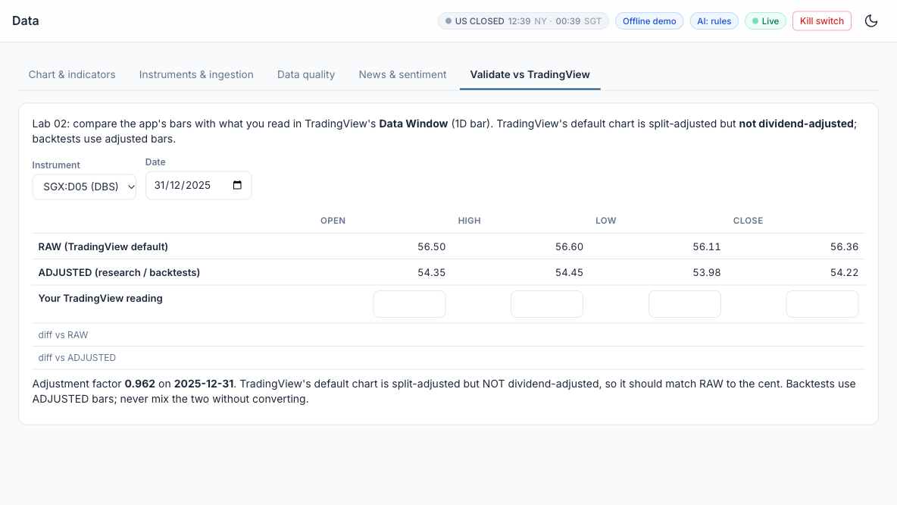
LAB 02 · SIMULATOR
Lab 02 — In the Trading Simulator
Course Labs > Lab 02 at http://localhost:8000 - Data > Validate vs TradingView (AAPL). Offline demo data; connect Alpaca paper keys for live paper trading.
Machine Learning 101 for Financial Trading · FSE-DAT-3019-1.1 · v2.4
© Tertiary Infotech Academy Pte Ltd
70

Slide 71
TOPIC 1 · HANDS-ON LAB
A6 K9
Ingestion Stage: Multi-Timeframe Bars, Headlines and Data Quality
LAB 03
Ingest bars from Alpaca / Twelve Data / yfinance (or the demo files), run the data-quality checks and score news sentiment.
WORKFLOW
1
2
3
4
Simulator: Fetch data
▶
Simulator: Read the data-quality report
▶
Simulator: Switch timeframes
▶
Simulator: Headlines and sentiment
YOU'LL PRODUCE
Duration
20 min
A cached universe, a data-quality report and scored headlines with daily sentiment.
Machine Learning 101 for Financial Trading · FSE-DAT-3019-1.1 · v2.4
© Tertiary Infotech Academy Pte Ltd
71

Slide 72
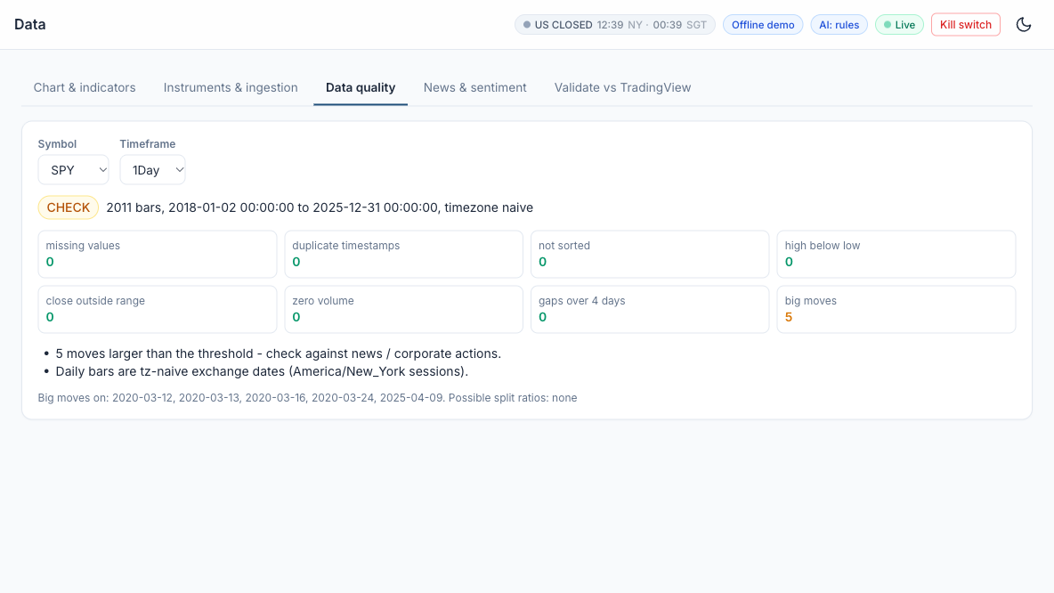
LAB 03 · SIMULATOR
Lab 03 — In the Trading Simulator
Course Labs > Lab 03 at http://localhost:8000 - Data > Fetch AAPL. Offline demo data; connect Alpaca paper keys for live paper trading.
Machine Learning 101 for Financial Trading · FSE-DAT-3019-1.1 · v2.4
© Tertiary Infotech Academy Pte Ltd
72

Slide 73
Lunch Break
1 hour · see you at 13:30
Machine Learning 101 for Financial Trading · FSE-DAT-3019-1.1 · v2.4
© Tertiary Infotech Academy Pte Ltd
73

Slide 74
TOPIC 1 · HANDS-ON LAB
A1 A6 K1
Hypothesis Stage: from a Written Card to an Automated Statistical Test
LAB 04
Write H0 and H1 before looking at results and test them with a Welch t-test and a bootstrap CI.
WORKFLOW
1
2
3
Simulator: Write the hypothesis card
▶
Simulator: Run the test
▶
Simulator: Robustness and multiple testing
YOU'LL PRODUCE
Duration
15 min
A decision (SUPPORTED / NOT SUPPORTED) with p-value, edge in bps and a robustness grid.
Machine Learning 101 for Financial Trading · FSE-DAT-3019-1.1 · v2.4
© Tertiary Infotech Academy Pte Ltd
74

Slide 75
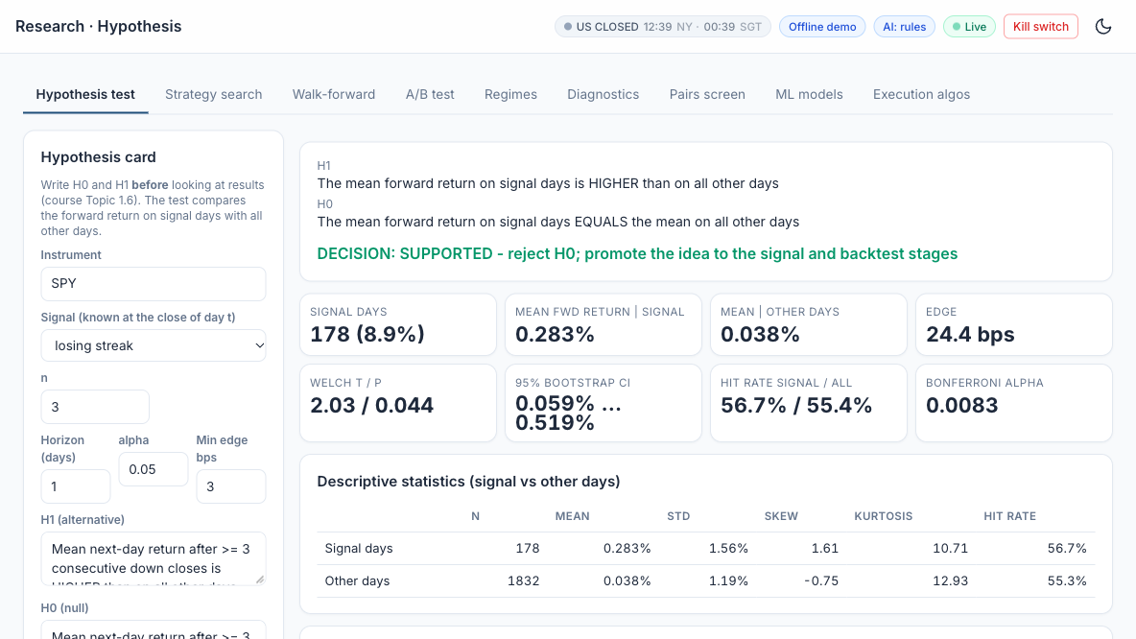
LAB 04 · SIMULATOR
Lab 04 — In the Trading Simulator
Course Labs > Lab 04 at http://localhost:8000 - Research > Hypothesis (SPY, losing streak 3). Offline demo data; connect Alpaca paper keys for live paper trading.
Machine Learning 101 for Financial Trading · FSE-DAT-3019-1.1 · v2.4
© Tertiary Infotech Academy Pte Ltd
75

Slide 76
TOPIC 1 · WHAT YOU COVERED
A1 A6 K1 K9
Topic 1 Recap
1
A1
Develop hypotheses for implementing data analytics and computational modelling activities
2
A6
Identify possible big data applications
3
K1
Data analytics and modelling business use cases
4
K9
Forms of data within financial services
Machine Learning 101 for Financial Trading · FSE-DAT-3019-1.1 · v2.4
© Tertiary Infotech Academy Pte Ltd
76

Slide 77
02
TOPIC 2
Indicators, Strategies and Metrics
LEARNING OUTCOME
Identify appropriate statistical algorithms and data models to test trading hypotheses, and use appropriate analytics platforms, analytical tools and statistical methods given specific analytics and reporting requirements.
Abilities A2, A3 · Knowledge K3, K5, K7 · Day 1 · Labs 5–9 · Assessed by PP Task 2 and WA Q3, Q5, Q7
Machine Learning 101 for Financial Trading · FSE-DAT-3019-1.1 · v2.4
© Tertiary Infotech Academy Pte Ltd
77

Slide 78
TOPIC 2 · K3
K3
Trend and Momentum Indicators
SMA / EMA
Average close over n bars; EMA weights recent bars by 2/(n+1).
MACD
EMA12 − EMA26 with a 9-EMA signal line; crosses flag momentum.
1
2
RSI (14)
100 − 100/(1+RS); above 70 overbought, below 30 oversold.
Donchian channel
Highest high / lowest low of n bars — the breakout level.
3
4
Machine Learning 101 for Financial Trading · FSE-DAT-3019-1.1 · v2.4
© Tertiary Infotech Academy Pte Ltd
78

Slide 79

TOPIC 2 · K3 · INDICATOR
K3
Indicator: Moving Averages (SMA and EMA)
DEFINITION
The average closing price over the last n bars - a smoothed line that shows the trend. The EMA weights recent bars more, so it turns sooner.
FORMULA
SMA(n) = (C1 + C2 + ... + Cn) / n. EMA(t) = a x C(t) + (1 - a) x EMA(t-1), with a = 2 / (n + 1).
HOW TO READ IT
Price above a rising average = uptrend. The 50 / 200-day pair is the classic trend filter; EMA 20 tracks the short-term trend.
INSIGHT
Every average lags: the longer n, the smoother - and the later each signal. In sideways markets price whipsaws across it.
Machine Learning 101 for Financial Trading · FSE-DAT-3019-1.1 · v2.4
© Tertiary Infotech Academy Pte Ltd
79

Slide 80

TOPIC 2 · K3 · INDICATOR
K3
Indicator: MACD (Moving Average Convergence Divergence)
DEFINITION
A momentum-of-trend gauge: the gap between a fast and a slow EMA, with a signal line and a histogram that show whether momentum is growing.
FORMULA
MACD = EMA12(C) - EMA26(C). Signal = EMA9(MACD). Histogram = MACD - Signal.
HOW TO READ IT
MACD crossing above its signal line = momentum turning up; MACD above zero = the 12-day trend is above the 26-day trend.
INSIGHT
A shrinking histogram warns that a move is losing strength before price turns - but it is built from EMAs, so it lags and whipsaws in ranges.
Machine Learning 101 for Financial Trading · FSE-DAT-3019-1.1 · v2.4
© Tertiary Infotech Academy Pte Ltd
80

Slide 81

TOPIC 2 · K3 · INDICATOR
K3
Indicator: RSI (Relative Strength Index)
DEFINITION
An oscillator from 0 to 100 that compares the size of recent gains with recent losses - how stretched the latest move is.
FORMULA
RS = average gain / average loss over n bars (Wilder smoothing, n = 14). RSI = 100 - 100 / (1 + RS).
HOW TO READ IT
Above 70 = overbought, below 30 = oversold. Short look-backs such as RSI(2) are used for mean-reversion entries.
INSIGHT
In a strong trend RSI can stay above 70 for weeks: overbought is not a sell signal by itself. Test the thresholds - they are conventions.
Machine Learning 101 for Financial Trading · FSE-DAT-3019-1.1 · v2.4
© Tertiary Infotech Academy Pte Ltd
81

Slide 82
TOPIC 2 · K3 · INDICATOR
K3
RSI(N): the Number Is the Look-back Period
RSI(2) - short look-back
RSI(14) - Wilder's standard (1978)
Look-back
The last 2 bars (days on a daily chart)
The last 14 bars - about 3 trading weeks
Reacts to
1-2 day moves: fast and jumpy
Sustained moves: smooth and slower
How often extreme
Often: SPY RSI(2) < 10 on 9.6% of days
Rarely: SPY RSI(14) < 30 on 1.7% of days
Typical levels
Buy below 10, exit above 70 (simulator default)
Buy below 30, sell above 70
SPY, 10 Oct 2025 (-2.7% after a -0.3% day)
5.8 - deeply oversold: the RSI(2) rule buys
42.5 - neutral: no signal
Next trading day, 13 Oct
SPY +1.5% - the bounce is captured
No trade
Simulator strategy
RSI(2) mean reversion (Connors style)
RSI oversold / overbought
Machine Learning 101 for Financial Trading · FSE-DAT-3019-1.1 · v2.4
© Tertiary Infotech Academy Pte Ltd
82

Slide 83
TOPIC 2 · K3 · INDICATOR
K3
The Number in Brackets Is Always the Look-back
RSI(N) formula
RS = average gain / average loss over the last N bars; RSI = 100 - 100 / (1 + RS). Mostly up days: near 100. Mostly down: near 0. Equal: 50.
SMA(50) and EMA(20)
SMA(50): average of the last 50 closes. EMA(20): exponential average over about 20 bars, weighting recent bars more.
1
2
Bollinger(20, 2) and ATR(14)
Bollinger: 20-day average with bands 2 standard deviations away. ATR(14): average true range over 14 bars.
Where to change N
TradingView: the indicator's Settings > Inputs > Length. Simulator: the strategy's parameter (e.g. RSI length n) before you backtest.
3
4
Machine Learning 101 for Financial Trading · FSE-DAT-3019-1.1 · v2.4
© Tertiary Infotech Academy Pte Ltd
83

Slide 84

TOPIC 2 · K3 · INDICATOR
K3
Indicator: Donchian Channel
DEFINITION
A channel drawn through the highest high and the lowest low of the last n bars - the levels a breakout must clear.
FORMULA
Upper(n) = max(High, last n bars). Lower(n) = min(Low, last n bars). Classic n = 20 (the Turtle traders used 20 and 55).
HOW TO READ IT
A close above the prior upper band = upside breakout; exit on a break of a shorter (e.g. 10-day) low.
INSIGHT
Breakout systems win rarely but big. Compare today's close with the channel up to YESTERDAY - including today's high is look-ahead.
Machine Learning 101 for Financial Trading · FSE-DAT-3019-1.1 · v2.4
© Tertiary Infotech Academy Pte Ltd
84

Slide 85
TOPIC 2 · K3
K3
Volatility and Volume Indicators
Bollinger Bands
SMA20 ± 2 standard deviations; width tracks volatility.
ATR (14)
Average true range — position sizing and volatility stops.
1
2
VWAP
Volume-weighted average price — the execution benchmark.
OBV
Adds volume on up days, subtracts on down days.
3
4
Machine Learning 101 for Financial Trading · FSE-DAT-3019-1.1 · v2.4
© Tertiary Infotech Academy Pte Ltd
85

Slide 86

TOPIC 2 · K3 · INDICATOR
K3
Indicator: Bollinger Bands
DEFINITION
A moving average with bands set a number of standard deviations above and below it, so the bands widen and narrow with volatility.
FORMULA
Middle = SMA20(C). Upper / Lower = Middle +/- 2 x StDev20(C). %B = (C - Lower) / (Upper - Lower).
HOW TO READ IT
Mean reversion: buy a close below the lower band, exit at the middle. A 'squeeze' (narrow bands) often comes before a big move.
INSIGHT
Returns are not normal: closes fall outside the bands far more often than the 5% a normal curve implies. In a trend, 'oversold' keeps falling.
Machine Learning 101 for Financial Trading · FSE-DAT-3019-1.1 · v2.4
© Tertiary Infotech Academy Pte Ltd
86

Slide 87

TOPIC 2 · K3 · INDICATOR
K3
Indicator: ATR (Average True Range)
DEFINITION
The average size of a day's price range, including overnight gaps - a volatility ruler in price units.
FORMULA
TR = max(H - L, |H - previous C|, |L - previous C|). ATR = average of TR over n bars (Wilder smoothing, n = 14).
HOW TO READ IT
Set stops at 2-3 x ATR and size positions as risk budget / (k x ATR), so every trade carries similar risk.
INSIGHT
ATR says how far, not which way. Compare instruments with ATR as a % of price, since ATR rises with the price level.
Machine Learning 101 for Financial Trading · FSE-DAT-3019-1.1 · v2.4
© Tertiary Infotech Academy Pte Ltd
87

Slide 88

TOPIC 2 · K3 · INDICATOR
K3
Indicator: VWAP (Volume-Weighted Average Price)
DEFINITION
The average price paid during the session, weighted by the volume traded at each price. It resets at every session open.
FORMULA
Typical price P = (H + L + C) / 3. VWAP = sum(P x Volume) / sum(Volume), summed from the session open.
HOW TO READ IT
The execution benchmark: buying below VWAP is a good fill. Intraday traders read price above VWAP as buyers in control.
INSIGHT
Institutions judge execution algorithms against VWAP. It needs intraday data - on daily bars it is only an approximation.
Machine Learning 101 for Financial Trading · FSE-DAT-3019-1.1 · v2.4
© Tertiary Infotech Academy Pte Ltd
88

Slide 89

TOPIC 2 · K3 · INDICATOR
K3
Indicator: OBV (On-Balance Volume)
DEFINITION
A running total of volume that adds a day's volume when the close rises and subtracts it when the close falls.
FORMULA
OBV(t) = OBV(t-1) + Volume(t) if C(t) > C(t-1); - Volume(t) if C(t) < C(t-1); unchanged if equal.
HOW TO READ IT
A rising OBV confirms an up-trend; OBV making new highs before price is read as accumulation. Read the slope, not the level.
INSIGHT
Volume shows the conviction behind a move. An OBV that falls while price rises (divergence) is a warning, not a signal on its own.
Machine Learning 101 for Financial Trading · FSE-DAT-3019-1.1 · v2.4
© Tertiary Infotech Academy Pte Ltd
89

Slide 90
TOPIC 2 · A2
A2
Matching the Method to the Hypothesis
'Does the signal beat the benchmark?'
Backtest + t-test or bootstrap on returns.
'Will tomorrow be up?'
Classifier: logistic regression, random forest, XGBoost.
1
2
'What state is the market in?'
Clustering: K-means on return and volatility features.
'Which parameters?'
Grid search in-sample, confirm out-of-sample.
3
4
Machine Learning 101 for Financial Trading · FSE-DAT-3019-1.1 · v2.4
© Tertiary Infotech Academy Pte Ltd
90

Slide 91
TOPIC 2 · K7
K7
Coding Languages for Algorithms and Signals
Pine Script v6
//@version=6 · ta.ema · ta.crossover · strategy.entry.
Python
Signals as pandas Series of +1 / 0 / −1 aligned to bars.
1
2
C++ / Java
Low-latency execution engines and exchange gateways.
R, SQL, MQL
Statistics, data stores, MetaTrader expert advisors.
3
4
Machine Learning 101 for Financial Trading · FSE-DAT-3019-1.1 · v2.4
© Tertiary Infotech Academy Pte Ltd
91

Slide 92
TOPIC 2 · K7
K7
Order Types and Time in Force
Market and limit
Certainty of fill versus control of price.
Stop, stop-limit, trailing stop
Trigger on a price; protect or enter on breaks.
1
2
Bracket / OCO / OTO
Entry with attached take-profit and stop-loss.
day · gtc · opg · cls · ioc · fok
How long an order stays working.
3
4
Machine Learning 101 for Financial Trading · FSE-DAT-3019-1.1 · v2.4
© Tertiary Infotech Academy Pte Ltd
92

Slide 93
TOPIC 2 · K3
K3
Performance and Risk Metrics
Return
Total return · CAGR = (end/start)^(1/years) − 1.
Risk
Volatility = σ(daily) × √252 · maximum drawdown.
1
2
Risk-adjusted
Sharpe · Sortino · Calmar = CAGR / |MaxDD|.
Trade quality
Win rate · profit factor · expectancy · turnover · exposure.
3
4
Machine Learning 101 for Financial Trading · FSE-DAT-3019-1.1 · v2.4
© Tertiary Infotech Academy Pte Ltd
93

Slide 94

TOPIC 2 · K3 · METRIC
K3
Metric: Sharpe Ratio
DEFINITION
Return earned per unit of risk taken: the average excess return divided by its volatility, annualised.
FORMULA
Sharpe = (mean daily return - daily risk-free rate) / std of daily returns x sqrt(252).
HOW TO READ IT
Below 0.5 weak, about 1 good, above 2 rare for a daily strategy - check for errors. Always compare with buy-and-hold over the same period.
INSIGHT
Volatility counts as risk whether it is up or down, and a short or costless backtest inflates it - 2020 returned 18% but at 33% volatility, a Sharpe of only 0.67.
Machine Learning 101 for Financial Trading · FSE-DAT-3019-1.1 · v2.4
© Tertiary Infotech Academy Pte Ltd
94

Slide 95

TOPIC 2 · K3 · METRIC
K3
Metric: Maximum Drawdown
DEFINITION
The largest fall of the equity curve from a previous peak to a later low - the worst loss an investor would have lived through before a new high.
FORMULA
Drawdown(t) = equity(t) / running peak(t) - 1. Max drawdown = the most negative drawdown over the period.
HOW TO READ IT
A -20% drawdown needs +25% to recover; -50% needs +100%. Compare with buy-and-hold and with the loss the investor can tolerate.
INSIGHT
One path-dependent number: it does not say how long recovery took, and a short backtest may simply miss a bad period. SPY 2018-2025: -33.7% in five weeks of 2020.
Machine Learning 101 for Financial Trading · FSE-DAT-3019-1.1 · v2.4
© Tertiary Infotech Academy Pte Ltd
95

Slide 96
TOPIC 2 · K3 · CLASSIFICATION
K3
Classification of Trading Algorithms by Purpose
Purpose
Examples
Execution algorithms
Work a large order at low cost and market impact
VWAP, TWAP, POV, implementation shortfall, iceberg, smart order routing
Market making
Quote bids and offers, earn the spread, manage inventory
Passive market making with resting limit orders
Arbitrage
Capture mispricing between related products or markets
ETF versus its basket, index futures versus stocks
Directional / alpha
Take a view on the direction of price
Trend following, momentum, breakout, mean reversion, news
Statistical arbitrage and pairs
Hedged: long one asset, short a related one; trade the spread
Pairs trading, cointegration, market-neutral baskets
Factor and portfolio
Build and rebalance portfolios from return drivers and risk
Value, momentum, size factors; mean-variance optimisation
Hedging and risk
Offset unwanted exposure and enforce limits
Delta hedging, beta hedging, pairs hedge, kill switch
Machine Learning 101 for Financial Trading · FSE-DAT-3019-1.1 · v2.4
© Tertiary Infotech Academy Pte Ltd
96

Slide 97
TOPIC 2 · K3 · CLASSIFICATION
K3
SEC Classification of High-Frequency Strategies (2010)
Passive market making
Submits non-marketable resting bids and offers that provide liquidity at specified prices
Arbitrage
Captures pricing inefficiencies between related products or markets, e.g. an ETF and its basket
1
2
Structural
Exploits structural vulnerabilities in the market or its participants, e.g. stale quotes via faster data
Directional
Takes a short-term position anticipating an intraday price move in a particular direction
3
4
Machine Learning 101 for Financial Trading · FSE-DAT-3019-1.1 · v2.4
© Tertiary Infotech Academy Pte Ltd
97

Slide 98
TOPIC 2 · K3 · CLASSIFICATION
K3
Classification by Holding Period
Horizon
Typical algorithms
High-frequency
Microseconds to seconds
Market making, ETF and latency arbitrage
Intraday
Minutes to hours
VWAP / TWAP execution, intraday momentum
Swing
Days to weeks
Mean reversion, pairs trading
Position
Weeks to months
Trend following, factor portfolios
Machine Learning 101 for Financial Trading · FSE-DAT-3019-1.1 · v2.4
© Tertiary Infotech Academy Pte Ltd
98

Slide 99
TOPIC 2 · K3 · CLASSIFICATION
K3
Classification by Model Type
1
Rule-based
Fixed if-then rules on indicators, e.g. a moving-average crossover
2
Statistical
Econometric tests and models: cointegration, regression, t-tests
3
Machine learning
Models learn from labelled data: logistic regression, random forest, XGBoost
4
Reinforcement learning
Learns a policy from rewards, e.g. order-execution research
5
LLM and agentic
Language models read text and agents plan, code and act under limits
Machine Learning 101 for Financial Trading · FSE-DAT-3019-1.1 · v2.4
© Tertiary Infotech Academy Pte Ltd
99

Slide 100
TOPIC 2 · K3
K3
Long and Short Positions
Long
Short
What you hold
Shares you own
Shares you borrowed and sold - you owe them back
Opening trade
Buy
Sell (the borrowed shares)
Closing trade
Sell
Buy back ('buy to cover') and return the shares
You profit when
The price rises
The price falls
Example
Buy SPY at $500, sell at $550: +$50
Sell SPY at $500, buy back at $450: +$50
Maximum loss
What you paid - a price cannot go below $0
Unlimited - a price can keep rising
Extra requirements
Only the cash to pay for the shares
A margin account (Alpaca: $2,000+ equity); borrow fees on hard-to-borrow stocks (Alpaca: $0 on easy-to-borrow)
Machine Learning 101 for Financial Trading · FSE-DAT-3019-1.1 · v2.4
© Tertiary Infotech Academy Pte Ltd
100

Slide 101
TOPIC 2 · K3
K3
Long and Short in Practice
'Long = buy, short = sell' is shorthand
Opening a long is a buy; opening a short is a sell. Selling shares you already own only closes the long - you go flat, not short.
Pine Script (TradingView)
strategy.entry("Long", strategy.long) opens a buy; strategy.close("Long") sells back to flat; strategy.short opens a short.
1
2
Trading Simulator
Most strategies are long-only: buy, then sell back to cash. 'RSI oversold / overbought' has an allow_short option that goes short above RSI 70.
Pairs trading (Lab 14)
Long the cheap stock and short the rich one at the same time: the trade profits from the gap closing, whichever way the market moves.
3
4
Machine Learning 101 for Financial Trading · FSE-DAT-3019-1.1 · v2.4
© Tertiary Infotech Academy Pte Ltd
101

Slide 102
TOPIC 2 · K3
K3
Strategy Families at a Glance (1 of 2)
1
Trend following
Rides sustained moves in the direction of the trend; cuts losers quickly - e.g. Buy when the 50-day moving average crosses above the 200-day
2
Mean reversion
Bets that prices stretched far from their average will snap back - e.g. Buy when price closes below the lower Bollinger Band (20-day, 2 std dev)
3
Momentum and breakout
Buys recent winners or prices breaking out of a range, expecting them to keep going - e.g. Buy on a close above the 20-day high (Donchian channel breakout)
4
Statistical / pairs arbitrage
Trades the spread between two related assets when it drifts from its normal level - e.g. Short the rich leg, buy the cheap leg when the spread z-score exceeds 2
Machine Learning 101 for Financial Trading · FSE-DAT-3019-1.1 · v2.4
© Tertiary Infotech Academy Pte Ltd
102

Slide 103
TOPIC 2 · K3
K3
Strategy Families at a Glance (2 of 2)
1
Execution algorithms
Split a large order to minimise cost and market impact: VWAP, TWAP, POV, implementation shortfall - e.g. POV: trade 10% of market volume until the order is filled
2
Market making
Continuously quotes buy and sell prices, earning the spread while managing inventory - e.g. Quote bid and ask around mid-price; skew quotes as inventory builds
3
Index rebalancing / event-driven
Trades predictable flows around index changes, earnings and corporate events - e.g. Position ahead of announced index inclusions on the rebalance date
4
Sentiment / NLP
Turns news, filings and social media text into trading signals using NLP or LLMs - e.g. Go long when the average FinBERT headline sentiment is strongly positive
Machine Learning 101 for Financial Trading · FSE-DAT-3019-1.1 · v2.4
© Tertiary Infotech Academy Pte Ltd
103

Slide 104
TOPIC 2 · K3 · STRATEGY FAMILIES
K3
Strategy Family: Trend Following
The idea
When it works
When it will not work
Prices that have started to move tend to keep moving. Buy when a fast average is above a slow one (or price is above its 200-day average); exit when the trend turns.
Long, persistent moves - bull or bear markets, macro trends lasting months. A few big winners pay for many small losses.
Sideways, choppy markets: price crosses the averages again and again (whipsaws), every crossing costs money, and signals arrive late at turns.
Lab 7: EMA 20/50 on SPY
Machine Learning 101 for Financial Trading · FSE-DAT-3019-1.1 · v2.4
© Tertiary Infotech Academy Pte Ltd
104

Slide 105
TOPIC 2 · K3 · STRATEGY FAMILIES
K3
Strategy Family: Mean Reversion
The idea
When it works
When it will not work
Like a rubber band, short-term over-reactions snap back. Buy when price is stretched below its normal range (lower Bollinger Band, RSI(2) below 10) and sell when it returns to the average.
Range-bound, liquid markets and stable large stocks, where extremes tend to snap back within days.
A real trend or a news shock: 'cheap' keeps getting cheaper. A high win rate hides rare large losses - as in March 2020.
Lab 7: Bollinger 20 / k = 2.0 and 1.5 on KO
Machine Learning 101 for Financial Trading · FSE-DAT-3019-1.1 · v2.4
© Tertiary Infotech Academy Pte Ltd
105

Slide 106
TOPIC 2 · K3 · STRATEGY FAMILIES
K3
Mean Reversion Rules in the Simulator
Buy when 'too low'
Exit
Bollinger Band mean reversion
Close below the lower band (20-day mean - 2 standard deviations)
Price returns to the middle band (the 20-day mean)
RSI oversold / overbought
RSI(14) below 30 - oversold
RSI(14) above 70 - overbought
RSI(2) mean reversion
RSI(2) below 10 - a sharp 1-2 day drop
RSI(2) above 70 - the bounce
Dip buy after a losing streak
3 or more down closes in a row (the Lab 4 hypothesis)
After the holding horizon, e.g. the next day
Machine Learning 101 for Financial Trading · FSE-DAT-3019-1.1 · v2.4
© Tertiary Infotech Academy Pte Ltd
106

Slide 107
TOPIC 2 · K3 · STRATEGY FAMILIES
K3
Mean Reversion versus Trend Following
Mean reversion
Trend following / momentum
Belief
Extremes snap back to the average
What is moving keeps moving
After a big drop
Buy
Sell or stay out
Works best in
Range-bound, sideways markets
Strongly trending markets
Typical horizon
Short: days
Longer: weeks to months
Win rate
High - many small wins
Low - few but large wins
Main danger
A rare big loss when the dip becomes a crash
Many small losses in choppy markets
Machine Learning 101 for Financial Trading · FSE-DAT-3019-1.1 · v2.4
© Tertiary Infotech Academy Pte Ltd
107

Slide 108
TOPIC 2 · K3 · STRATEGY FAMILIES
K3
Mean Reversion: the Main Risk and Three Safeguards
The risk
1 Stop-loss or time limit
2 Trend filter
3 Stable markets
The rule assumes the average holds. After a real change - a crash, bad news, a broken business - price does not come back: buying the dip becomes catching a falling knife.
Cap the rare big loss: exit at a fixed loss, or after n days if the bounce has not come.
Only buy dips while price is above its 200-day SMA, so you are not buying into a bear market.
Liquid, defensive stocks such as KO, and pairs trading (Lab 14: the spread between two linked stocks) revert more reliably.
Lab 7: Bollinger on KO - high win rate, but losses larger than wins: many small wins, rare big losses.
Machine Learning 101 for Financial Trading · FSE-DAT-3019-1.1 · v2.4
© Tertiary Infotech Academy Pte Ltd
108

Slide 109
TOPIC 2 · K3 · STRATEGY FAMILIES
K3
Strategy Family: Momentum
The idea
When it works
When it will not work
Winners keep winning for months. Buy what has risen over the last 6-12 months (time-series) or what has risen most among its peers (cross-sectional).
Persistent market or sector themes, spread across many assets and rebalanced regularly.
Sharp reversals - 'momentum crashes' such as the 2009 rebound, when last year's losers rally hardest - and choppy markets that churn the portfolio.
Lab 7: 126-day time-series momentum on QQQ
Machine Learning 101 for Financial Trading · FSE-DAT-3019-1.1 · v2.4
© Tertiary Infotech Academy Pte Ltd
109

Slide 110
TOPIC 2 · K3 · STRATEGY FAMILIES
K3
Strategy Family: Breakout
The idea
When it works
When it will not work
A close above the recent range (for example the 20-day high, the Donchian channel) signals the start of a new move: buy the breakout, exit on a shorter low.
Volatility expanding after a quiet period and a new trend starting - indices and commodities in strong regimes.
False breakouts in a range: price pokes above the high and falls back. A low win rate, so exits must be disciplined and costs kept low.
Lab 7: Donchian 20 / 10 on QQQ
Machine Learning 101 for Financial Trading · FSE-DAT-3019-1.1 · v2.4
© Tertiary Infotech Academy Pte Ltd
110

Slide 111
TOPIC 2 · HOW THE ALGORITHMS WORK
Concepts over code
Every algorithm below is coded for you - by the simulator or an AI assistant. Learn what it does, when it works and what can go wrong; let AI handle the syntax.
Machine Learning 101 for Financial Trading · FSE-DAT-3019-1.1 · v2.4
© Tertiary Infotech Academy Pte Ltd
111

Slide 112

TOPIC 2 · K3
K3
Algorithm: Moving-Average Crossover (Trend Following)
HOW IT WORKS
Two moving averages of the close: a fast one reacts quickly, a slow one shows the trend.
RULE
Fast crosses ABOVE slow (golden cross): buy. Fast crosses BELOW (death cross): sell or go flat.
WORKS BEST WHEN
Markets trend for months - it rides the move and cuts losers when the trend turns.
WATCH OUT FOR
Whipsaws in sideways markets; signals lag; trade on the next bar, not the crossing bar.
Machine Learning 101 for Financial Trading · FSE-DAT-3019-1.1 · v2.4
© Tertiary Infotech Academy Pte Ltd
112

Slide 113

TOPIC 2 · K3
K3
Algorithm: Bollinger Band Mean Reversion
HOW IT WORKS
Bands = 20-day mean +/- 2 standard deviations. A close outside the band is 'stretched'.
RULE
Close below the lower band: buy. Exit when the price returns to the middle band (the mean).
WORKS BEST WHEN
Range-bound markets where over-reactions snap back, e.g. a defensive stock such as KO.
WATCH OUT FOR
Strong trends keep 'stretching' - add a stop-loss or a trend filter; many small wins, rare big losses.
Machine Learning 101 for Financial Trading · FSE-DAT-3019-1.1 · v2.4
© Tertiary Infotech Academy Pte Ltd
113

Slide 114

TOPIC 2 · K3
K3
Algorithm: RSI and MACD Momentum Oscillators
HOW IT WORKS
RSI = 100 - 100/(1+RS), RS = average gain / average loss over 14 bars. MACD = EMA12 - EMA26.
RULE
RSI < 30 oversold / > 70 overbought. MACD crossing above its 9-EMA signal line = momentum buy.
WORKS BEST WHEN
As filters or confirmation for a trend or mean-reversion rule, not as stand-alone predictors.
WATCH OUT FOR
Oscillators can stay overbought in strong trends; RSI and MACD are highly correlated with price.
Machine Learning 101 for Financial Trading · FSE-DAT-3019-1.1 · v2.4
© Tertiary Infotech Academy Pte Ltd
114

Slide 115

TOPIC 2 · K3
K3
Algorithm: Cross-Sectional Momentum
HOW IT WORKS
Rank a universe by past return (e.g. 12 months, skipping the last month) each month.
RULE
Hold the top-ranked assets, avoid or short the bottom-ranked; rebalance monthly.
WORKS BEST WHEN
Information spreads slowly and winners keep winning for several months.
WATCH OUT FOR
Sharp 'momentum crashes' when markets reverse; turnover costs at every rebalance.
Machine Learning 101 for Financial Trading · FSE-DAT-3019-1.1 · v2.4
© Tertiary Infotech Academy Pte Ltd
115

Slide 116

TOPIC 2 · K3
K3
Algorithm: Donchian Channel Breakout
HOW IT WORKS
Track the highest high and lowest low of the last n bars (n = 20 here).
RULE
Close above the 20-day high: buy the breakout. Exit below the 20-day low (or a trailing stop).
WORKS BEST WHEN
New trends start with a break of a range - the rule used by the 1980s 'Turtle Traders'.
WATCH OUT FOR
False breakouts in choppy markets; the channel must use PREVIOUS bars only (no look-ahead).
Machine Learning 101 for Financial Trading · FSE-DAT-3019-1.1 · v2.4
© Tertiary Infotech Academy Pte Ltd
116

Slide 117

TOPIC 2 · K3
K3
Algorithm: VWAP and TWAP Execution
HOW IT WORKS
Split a large parent order into child orders through the day to reduce market impact.
RULE
TWAP: equal slices per time interval. VWAP: slices proportional to the typical volume curve.
WORKS BEST WHEN
Working client or fund orders too large to trade at once; benchmarked to the day's VWAP.
WATCH OUT FOR
VWAP relies on a volume forecast; both are predictable to other traders - add randomisation.
Machine Learning 101 for Financial Trading · FSE-DAT-3019-1.1 · v2.4
© Tertiary Infotech Academy Pte Ltd
117

Slide 118

TOPIC 2 · K3
K3
Algorithm: Market Making
HOW IT WORKS
Quote a bid below and an ask above the mid price at the same time.
RULE
Earn the spread when both sides fill; skew quotes down when long, up when short, to cut inventory.
WORKS BEST WHEN
Liquid markets with steady two-way flow - the business of quant market makers.
WATCH OUT FOR
Adverse selection by better-informed traders; inventory risk in fast moves; needs low latency.
Machine Learning 101 for Financial Trading · FSE-DAT-3019-1.1 · v2.4
© Tertiary Infotech Academy Pte Ltd
118

Slide 119
TOPIC 2 · K5 · PLATFORMS
K5
TradingView versus Alpaca
TradingView
Alpaca
What it is
Charting and strategy-design platform
API-first US broker for automated trading
Markets
Global charts incl. SGX, US, FX, crypto
US stocks and ETFs, options, crypto
Strategy design
Pine Script v6 indicators and strategies
Through the API - in this course the Trading Simulator does it for you
Backtesting
Strategy Tester (simplified costs and fills)
None built in - the Trading Simulator runs the cost-aware backtest
Paper trading
Built-in Paper Trading account from the chart
Paper account mirroring the live API
Automation
Alerts; webhooks on paid plans
Trading API: orders, positions, clock; 24/5 trading
Data
Charts and Data Window
Market Data API: bars, quotes, trades, news (IEX free)
Machine learning
Not supported
Through code - in this course the Trading Simulator has built-in logistic regression, random forest and XGBoost
Best used for
Designing, visualising and first-testing a rule
Executing and forward-testing it automatically
Machine Learning 101 for Financial Trading · FSE-DAT-3019-1.1 · v2.4
© Tertiary Infotech Academy Pte Ltd
119

Slide 120
TOPIC 2 · K5 · PAPER TRADING
K5
Paper Trading on TradingView, Step by Step
Full step-by-step guide: Learner Guide, 'Platform Guides'.
1
2
3
4
5
6
▶
▶
▶
▶
▶
Supercharts > Trade > Paper Trading > Connect
Set starting capital and commission
Order ticket: side, quantity, Market / Limit / Stop
Add stop loss and take profit; place order
Track Positions, Orders, Account History
Close the position; reset when done
Paper fills use TradingView's prices but cannot show your own market impact - compare them with the backtest's assumed costs.
Machine Learning 101 for Financial Trading · FSE-DAT-3019-1.1 · v2.4
© Tertiary Infotech Academy Pte Ltd
120

Slide 121
TOPIC 2 · K5 · PAPER TRADING
K5
Paper Trading on Alpaca, Step by Step - Manual and Automated
Full step-by-step guide: Learner Guide, 'Platform Guides'.
1
2
3
4
5
6
▶
▶
▶
▶
▶
Dashboard: Paper account > search SPY > Buy
Watch Orders: new > accepted > filled
Outside US hours: extended-hours LIMIT orders
Simulator: Paper Trading > Order ticket
Simulator: + New bot > Start
Check dashboard; kill switch to stop
From Singapore the US regular session is 21:30-04:00 (22:30-05:00 in northern winter); class-time orders use Alpaca's 24/5 extended-hours limit orders.
Machine Learning 101 for Financial Trading · FSE-DAT-3019-1.1 · v2.4
© Tertiary Infotech Academy Pte Ltd
121

Slide 122
TOPIC 2 · K7
K7
The Order Lifecycle
A program must read the status — never assume a fill.
1
2
3
4
5
▶
▶
▶
▶
new
accepted
partially filled
filled
cancelled / expired / rejected
Bracket orders protect a position even if your program stops running.
Machine Learning 101 for Financial Trading · FSE-DAT-3019-1.1 · v2.4
© Tertiary Infotech Academy Pte Ltd
122

Slide 123
TOPIC 2 · A3
A3
From Idea to Tested Rule on TradingView
1
2
3
4
5
6
▶
▶
▶
▶
▶
Chart the instrument and timeframe
Add indicators (Pine)
Paste the exported strategy() script
Set commission and slippage
Read the Strategy Tester
Compare with buy-and-hold
The Strategy Tester is a first filter; the full test with costs runs in the Trading Simulator.
Machine Learning 101 for Financial Trading · FSE-DAT-3019-1.1 · v2.4
© Tertiary Infotech Academy Pte Ltd
123

Slide 124
TOPIC 2 · HANDS-ON LAB
A3 K3 K7
Indicator Stage: Pine Script v6 Indicators and their Python Twins
LAB 05
Plot SMA/EMA, Bollinger Bands, RSI and MACD and export a Pine Script v6 strategy for TradingView.
WORKFLOW
1
2
3
Simulator: Overlay trend indicators
▶
Simulator: Oscillators
▶
Simulator: Export Pine Script v6
YOU'LL PRODUCE
Duration
25 min
A chart with overlays and an oscillator pane, and a Pine Script pasted into TradingView whose values match.
Machine Learning 101 for Financial Trading · FSE-DAT-3019-1.1 · v2.4
© Tertiary Infotech Academy Pte Ltd
124

Slide 125
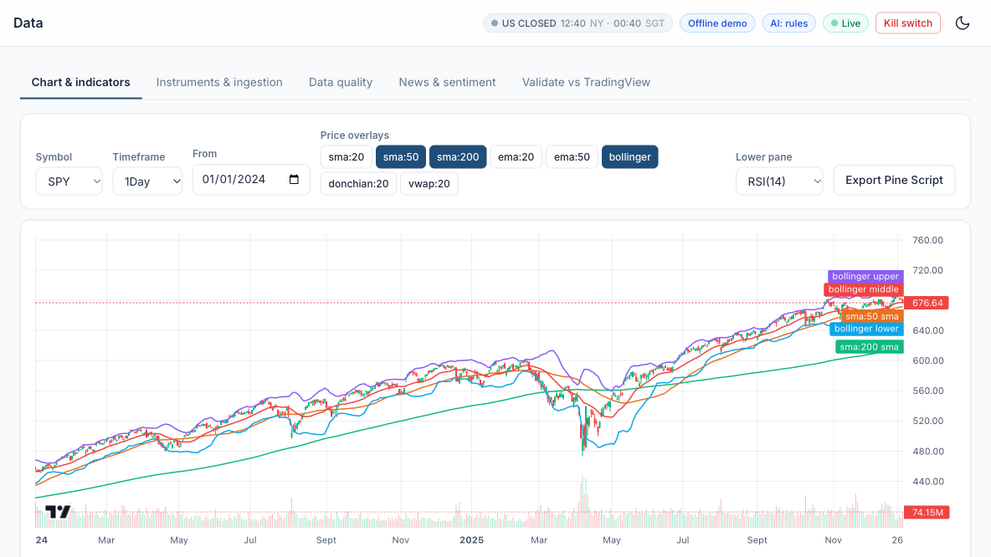
LAB 05 · SIMULATOR
Lab 05 — In the Trading Simulator
Course Labs > Lab 05 at http://localhost:8000 - Data > Chart SPY with SMA 50/200 and Bollinger. Offline demo data; connect Alpaca paper keys for live paper trading.
Machine Learning 101 for Financial Trading · FSE-DAT-3019-1.1 · v2.4
© Tertiary Infotech Academy Pte Ltd
125

Slide 126

LAB 05 · TRADINGVIEW
Lab 05 — The Exported Strategy in TradingView
The EMA crossover exported from the simulator as Pine Script v6, pasted into TradingView's Pine Editor and added to the SPY chart: the Strategy Tester reports PnL, drawdown and profitable trades to compare with the simulator's backtest.
Machine Learning 101 for Financial Trading · FSE-DAT-3019-1.1 · v2.4
© Tertiary Infotech Academy Pte Ltd
126

Slide 127
TOPIC 2 · HANDS-ON LAB
A2 A3 K3 K7
Strategy Prototype: TradingView Strategy Tester, Paper Trading from the Chart and Pipeline Reconciliation
LAB 06
Run the same MA-crossover in TradingView's Strategy Tester and in the app, reconcile the results, and try TradingView Paper Trading.
WORKFLOW
1
2
3
Simulator: Backtest the SMA 50/200 crossover in the app
▶
Simulator: Run it in TradingView
▶
Simulator: Reconcile and paper trade on TradingView
YOU'LL PRODUCE
Duration
30 min
Trade counts and net profit that agree within the expected differences (fills, costs, data).
Machine Learning 101 for Financial Trading · FSE-DAT-3019-1.1 · v2.4
© Tertiary Infotech Academy Pte Ltd
127

Slide 128
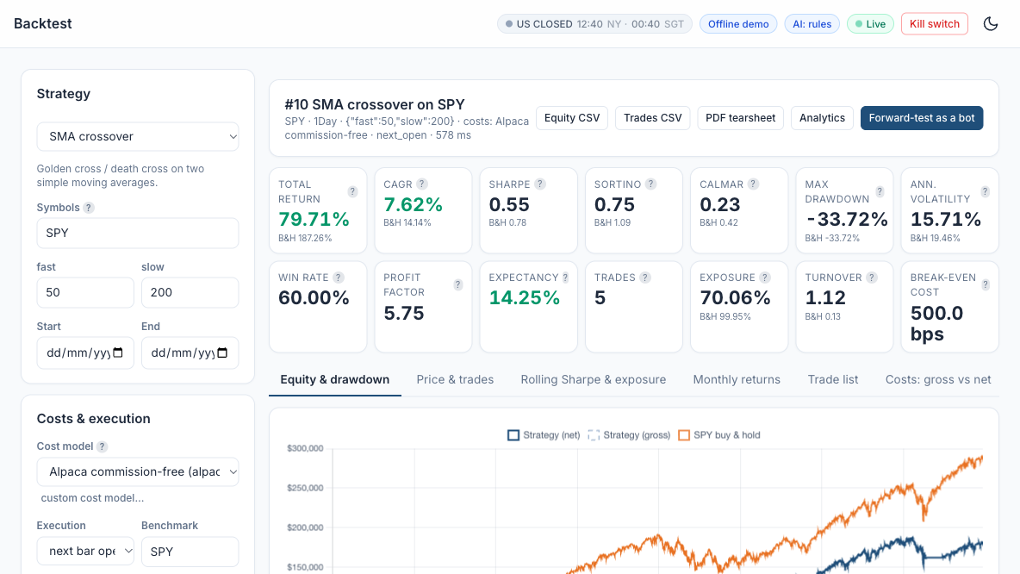
LAB 06 · SIMULATOR
Lab 06 — In the Trading Simulator
Course Labs > Lab 06 at http://localhost:8000 - Backtest SPY SMA 50/200, Alpaca costs. Offline demo data; connect Alpaca paper keys for live paper trading.
Machine Learning 101 for Financial Trading · FSE-DAT-3019-1.1 · v2.4
© Tertiary Infotech Academy Pte Ltd
128

Slide 129

LAB 06 · SIMULATOR
Lab 06 — The SMA 50/200 Backtest in the Simulator
Backtest: SMA crossover 50/200 on SPY with Alpaca commission-free costs and next-bar-open fills - return, CAGR, Sharpe, drawdown and trades beside buy-and-hold, ready to reconcile with TradingView's Strategy Tester.
Machine Learning 101 for Financial Trading · FSE-DAT-3019-1.1 · v2.4
© Tertiary Infotech Academy Pte Ltd
129

Slide 130
Tea Break
15 minutes · see you at 15:40
Machine Learning 101 for Financial Trading · FSE-DAT-3019-1.1 · v2.4
© Tertiary Infotech Academy Pte Ltd
130

Slide 131
TOPIC 2 · HANDS-ON LAB
A2 K3 K7
Signal Stage: a Library of Trend, Mean-Reversion, Momentum and Breakout Signals
LAB 07
Pick and customise one strategy from each family and compare them after costs.
WORKFLOW
1
2
3
4
Simulator: Trend: EMA 20/50 on SPY
▶
Simulator: Mean reversion: Bollinger on KO
▶
Simulator: Momentum and breakout
▶
Simulator: Read each strategy's explanation
YOU'LL PRODUCE
Duration
25 min
Four backtests with tuned parameters and an explanation of when each family works.
Machine Learning 101 for Financial Trading · FSE-DAT-3019-1.1 · v2.4
© Tertiary Infotech Academy Pte Ltd
131

Slide 132
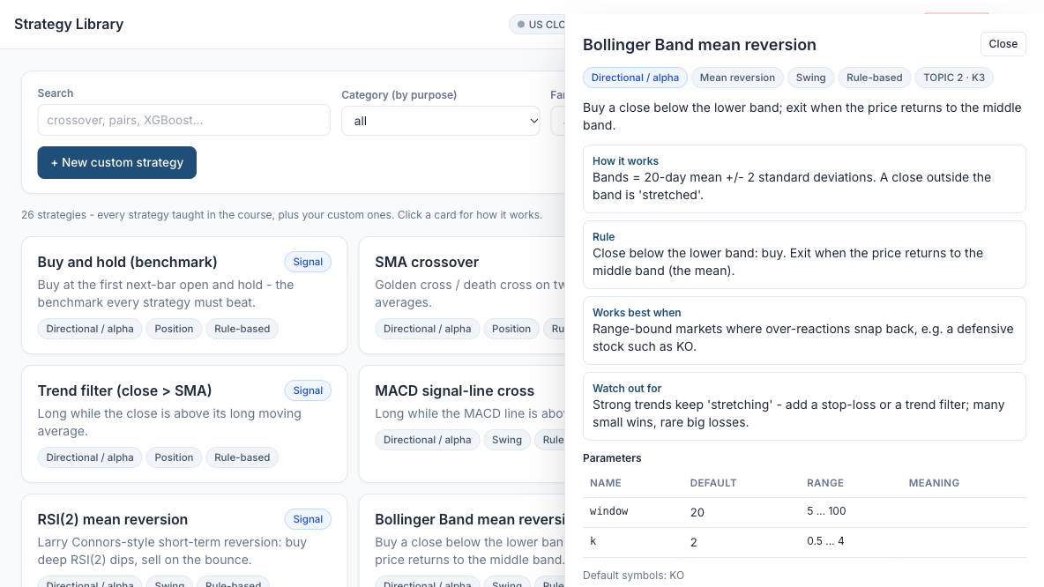
LAB 07 · SIMULATOR
Lab 07 — In the Trading Simulator
Course Labs > Lab 07 at http://localhost:8000 - Backtest SPY EMA 20/50, Alpaca costs. Offline demo data; connect Alpaca paper keys for live paper trading.
Machine Learning 101 for Financial Trading · FSE-DAT-3019-1.1 · v2.4
© Tertiary Infotech Academy Pte Ltd
132

Slide 133

LAB 07 · TRADINGVIEW
Lab 07 — Mean Reversion in TradingView, with Paper Trading
Bollinger Bands mean reversion (20, 2) on SPY with TradingView Paper Trading's order panel open. It lost 7.87% since 1993 though 59% of trades won: buying dips in a trending index hurts, so the lab runs it on KO.
Machine Learning 101 for Financial Trading · FSE-DAT-3019-1.1 · v2.4
© Tertiary Infotech Academy Pte Ltd
133

Slide 134
TOPIC 2 · HANDS-ON LAB
A3 K5
Execution Stage: an Order Manager that Trades the Paper Account in Any Session
LAB 08
Place market, limit, stop and bracket paper orders, including an extended-hours limit order, and follow each order's lifecycle.
WORKFLOW
1
2
3
4
Simulator: Market order in the regular session
▶
Simulator: Extended-hours limit order (Singapore class hours)
▶
Simulator: Bracket order
▶
Simulator: Queue while closed and cancel
YOU'LL PRODUCE
Duration
30 min
A blotter with filled, working, queued and cancelled orders and the risk checks for each.
Machine Learning 101 for Financial Trading · FSE-DAT-3019-1.1 · v2.4
© Tertiary Infotech Academy Pte Ltd
134

Slide 135
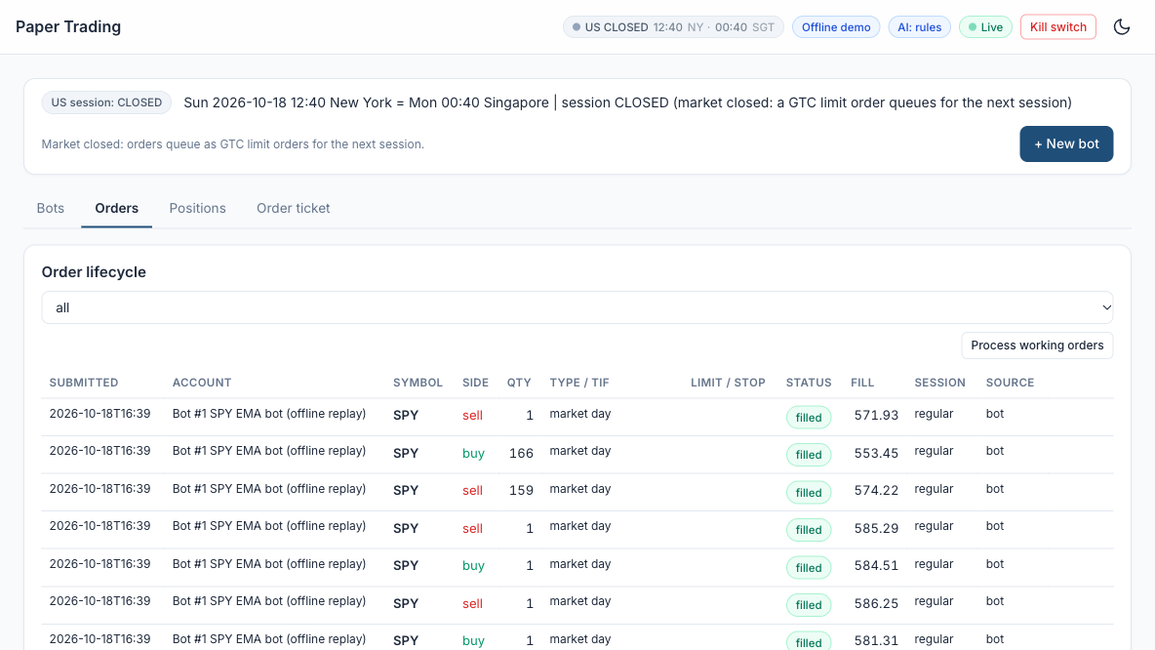
LAB 08 · SIMULATOR
Lab 08 — In the Trading Simulator
Course Labs > Lab 08 at http://localhost:8000 - Paper Trading > Order ticket. Offline demo data; connect Alpaca paper keys for live paper trading.
Machine Learning 101 for Financial Trading · FSE-DAT-3019-1.1 · v2.4
© Tertiary Infotech Academy Pte Ltd
135

Slide 136

LAB 08 · SIMULATOR
Lab 08 — The Paper Order Ticket
Paper Trading > Order ticket: buy 10 SPY, type auto (session-aware), time in force day, default paper account, Session (sim) = real clock. The banner shows the live session - here REGULAR, so all order types are accepted.
Machine Learning 101 for Financial Trading · FSE-DAT-3019-1.1 · v2.4
© Tertiary Infotech Academy Pte Ltd
136

Slide 137

LAB 08 · SIMULATOR
Lab 08 — Risk Checks Passed, Order Filled
After Send paper order: ACCEPTED, all checks passed - BUY 10 SPY MARKET DAY -> filled. Every manual order passes the same pre-trade checks as the bots: kill switch, duplicate, session, allow list, long only, daily loss, max order quantity and value, max position.
Machine Learning 101 for Financial Trading · FSE-DAT-3019-1.1 · v2.4
© Tertiary Infotech Academy Pte Ltd
137

Slide 138
TOPIC 2 · HANDS-ON LAB
A3 K3
Evaluation Stage: Performance and Risk Metrics with a Benchmark Table
LAB 09
Read the full metrics table and compare a strategy with buy-and-hold.
WORKFLOW
1
2
3
Simulator: Open the analytics
▶
Simulator: Compare with buy-and-hold
▶
Simulator: Glossary
YOU'LL PRODUCE
Duration
25 min
A metrics table you can explain line by line.
Machine Learning 101 for Financial Trading · FSE-DAT-3019-1.1 · v2.4
© Tertiary Infotech Academy Pte Ltd
138

Slide 139
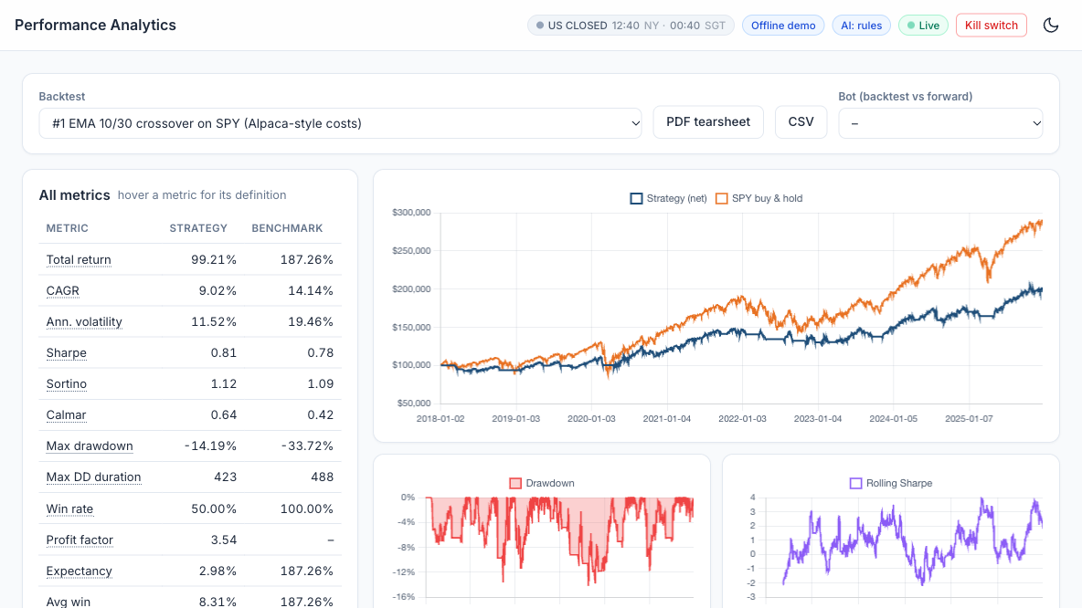
LAB 09 · SIMULATOR
Lab 09 — In the Trading Simulator
Course Labs > Lab 09 at http://localhost:8000 - Analytics. Offline demo data; connect Alpaca paper keys for live paper trading.
Machine Learning 101 for Financial Trading · FSE-DAT-3019-1.1 · v2.4
© Tertiary Infotech Academy Pte Ltd
139

Slide 140

LAB 09 · SIMULATOR
Lab 09 — Strategy versus Benchmark in Analytics
Performance Analytics for the SMA 50/200 backtest against SPY buy-and-hold: 79.71% versus 187.26% total return, Sharpe 0.55 versus 0.78 and the same -33.72% maximum drawdown, with drawdown, rolling Sharpe and monthly returns. Hover any metric for its definition.
Machine Learning 101 for Financial Trading · FSE-DAT-3019-1.1 · v2.4
© Tertiary Infotech Academy Pte Ltd
140

Slide 141
TOPIC 2 · WHAT YOU COVERED
A2 A3 K3 K5 K7
Topic 2 Recap
1
A2
Identify appropriate statistical algorithms and data models to test hypotheses and/or theories
2
A3
Use appropriate analytics platforms, analytical tools, statistical methods and analytical approaches given specific analytics and reporting requirements
3
K3
Range and application of various statistical methods and algorithms
4
K5
Usage of analytics platforms and tools
5
K7
Coding languages for programming of algorithms and signals
Machine Learning 101 for Financial Trading · FSE-DAT-3019-1.1 · v2.4
© Tertiary Infotech Academy Pte Ltd
141

Slide 142
End of Day 1
See you at 09:00 tomorrow
Machine Learning 101 for Financial Trading · FSE-DAT-3019-1.1 · v2.4
© Tertiary Infotech Academy Pte Ltd
142

Slide 143
03
TOPIC 3
ML Models and A/B Testing
LEARNING OUTCOME
Conduct statistical modelling of market data with machine learning models to derive patterns and solutions, and perform A/B testing of trading strategies based on different hypotheses.
Abilities A4, A5 · Knowledge K2, K4, K6 · Day 2 · Labs 10–14 · Assessed by PP Task 3 and WA Q2, Q4, Q6
Machine Learning 101 for Financial Trading · FSE-DAT-3019-1.1 · v2.4
© Tertiary Infotech Academy Pte Ltd
143

Slide 144
TOPIC 3 · K2
K2
Types of Statistical Analyses
Descriptive
What happened — mean return, volatility, skew, correlation.
Inferential
Is it real? — t-test, bootstrap, confidence intervals.
1
2
Predictive
What next? — regression, classification.
Prescriptive
What to do? — optimisation, position sizing.
3
4
Machine Learning 101 for Financial Trading · FSE-DAT-3019-1.1 · v2.4
© Tertiary Infotech Academy Pte Ltd
144

Slide 145
TOPIC 3 · K2
K2
Families of Learning Algorithms
Supervised
Features → known target: up/down, next return.
Unsupervised
Structure without a target: regimes, PCA factors.
1
2
Reinforcement
Learn a policy from rewards — execution research.
Search & simulation
Grid search, Monte Carlo, bootstrap, walk-forward.
3
4
Machine Learning 101 for Financial Trading · FSE-DAT-3019-1.1 · v2.4
© Tertiary Infotech Academy Pte Ltd
145

Slide 146
TOPIC 3 · K4
K4
Supervised Models for Trading Signals
Linear / logistic regression
Interpretable baselines; P(up) from a weighted sum.
Decision tree & random forest
Threshold splits; averaged trees reduce variance.
1
2
XGBoost
Sequential boosted trees — strongest on tabular features.
Neural networks
MLP, LSTM, Transformer — data-hungry, easy to overfit.
3
4
Machine Learning 101 for Financial Trading · FSE-DAT-3019-1.1 · v2.4
© Tertiary Infotech Academy Pte Ltd
146

Slide 147
TOPIC 3 · K4
K4
Unsupervised Models for Regimes
K-means
Minimise within-cluster variance; choose k by elbow or silhouette.
Hierarchical clustering
Dendrogram of similar assets for diversification.
1
2
PCA
First component ≈ the market; yield curve = level, slope, curvature.
Fit on the past only
Assign new days to regimes as they arrive.
3
4
Machine Learning 101 for Financial Trading · FSE-DAT-3019-1.1 · v2.4
© Tertiary Infotech Academy Pte Ltd
147

Slide 148
TOPIC 3 · K6
K6
Statistical Modelling Techniques
Returns, not prices
Closer to stationary; avoids spurious regression.
Time-ordered validation
TimeSeriesSplit and walk-forward — never shuffle.
1
2
Leak-free features
Lags and rolling windows known at decision time.
Regularise
L1/L2, depth limits, early stopping, fewer features.
3
4
Machine Learning 101 for Financial Trading · FSE-DAT-3019-1.1 · v2.4
© Tertiary Infotech Academy Pte Ltd
148

Slide 149
TOPIC 3 · A5
A5
A/B Testing Two Strategy Variants
State H0 and H1 first
H0: equal mean returns; H1: B is higher. α = 5%.
Welch's t-test
Compare mean daily returns with unequal variances.
1
2
Bootstrap the Sharpe difference
Resample returns; 95% CI excluding 0?
Mind multiple testing
100 variants → ~5 false 'winners' by chance.
3
4
Machine Learning 101 for Financial Trading · FSE-DAT-3019-1.1 · v2.4
© Tertiary Infotech Academy Pte Ltd
149

Slide 150

TOPIC 3 · K4
K4
Algorithm: Logistic Regression for Direction
HOW IT WORKS
Fits P(up tomorrow) = 1 / (1 + e^-(b0 + b1 x1 + ...)) from features known today.
RULE
Go long when P(up) exceeds a threshold such as 0.55; otherwise stay flat.
WORKS BEST WHEN
A transparent baseline: each coefficient shows how a feature moves the probability.
WATCH OUT FOR
Only linear effects unless you engineer features; daily direction is close to a coin toss.
Machine Learning 101 for Financial Trading · FSE-DAT-3019-1.1 · v2.4
© Tertiary Infotech Academy Pte Ltd
150

Slide 151

TOPIC 3 · K4
K4
Algorithm: Decision Tree and Random Forest
HOW IT WORKS
A tree splits the data on feature thresholds (e.g. RSI < 30) into leaves with an up/down share.
RULE
A random forest averages hundreds of trees, each grown on a random sample of rows and features.
WORKS BEST WHEN
Non-linear, interacting signals - e.g. oversold AND low volatility.
WATCH OUT FOR
Deep trees memorise noise; limit depth and leaf size and validate walk-forward.
Machine Learning 101 for Financial Trading · FSE-DAT-3019-1.1 · v2.4
© Tertiary Infotech Academy Pte Ltd
151

Slide 152

TOPIC 3 · K4
K4
Algorithm: Gradient Boosting (XGBoost)
HOW IT WORKS
Builds trees one after another; each new tree corrects the errors of the ensemble so far.
RULE
Prediction = sum of many small trees x learning rate; stop early when test loss stops falling.
WORKS BEST WHEN
Tabular features such as returns, indicators and volatility - usually the strongest model.
WATCH OUT FOR
Training loss keeps falling while test loss rises: classic overfitting (see the chart).
Machine Learning 101 for Financial Trading · FSE-DAT-3019-1.1 · v2.4
© Tertiary Infotech Academy Pte Ltd
152

Slide 153

TOPIC 3 · K4
K4
Algorithm: K-Means Clustering for Market Regimes
HOW IT WORKS
Groups days into k clusters by minimising the distance of each day to its cluster centre.
RULE
Features: rolling return and volatility (standardised). Name clusters by their averages.
WORKS BEST WHEN
Switching or sizing strategies by regime: trend in calm markets, cut risk when stressed.
WATCH OUT FOR
Fit on past data only; choose k with the elbow or silhouette method; regimes shift.
Machine Learning 101 for Financial Trading · FSE-DAT-3019-1.1 · v2.4
© Tertiary Infotech Academy Pte Ltd
153

Slide 154

TOPIC 3 · K4
K4
Algorithm: Principal Component Analysis (PCA)
HOW IT WORKS
Finds uncorrelated combinations of assets that explain the most variance of returns.
RULE
PC1 of a stock universe is 'the market'; later PCs are sector or style factors.
WORKS BEST WHEN
Reducing many correlated features; building factor-neutral and pairs portfolios.
WATCH OUT FOR
Standardise first; components change over time; PCs are statistical, not economic, factors.
Machine Learning 101 for Financial Trading · FSE-DAT-3019-1.1 · v2.4
© Tertiary Infotech Academy Pte Ltd
154

Slide 155

TOPIC 3 · K6
K6
Method: Walk-Forward Validation
HOW IT WORKS
Train on a past window, test on the next unseen block, then roll forward and repeat.
RULE
Never shuffle time series; each test block is genuinely out of sample.
WORKS BEST WHEN
Estimating how a model or parameter set would really have performed live.
WATCH OUT FOR
Overlapping targets leak information - leave a gap between train and test.
Machine Learning 101 for Financial Trading · FSE-DAT-3019-1.1 · v2.4
© Tertiary Infotech Academy Pte Ltd
155

Slide 156

TOPIC 3 · A5
A5
Method: A/B Testing Two Strategy Variants
HOW IT WORKS
Compare variant A and B on the same days: H0 'no difference' vs H1 'B is better'.
RULE
Welch / paired t-test on daily returns; bootstrap a 95% CI of the Sharpe difference.
WORKS BEST WHEN
Deciding which parameter set or filter to promote to paper trading.
WATCH OUT FOR
If the CI contains 0, do not reject H0; testing 100 variants gives ~5 false winners.
Machine Learning 101 for Financial Trading · FSE-DAT-3019-1.1 · v2.4
© Tertiary Infotech Academy Pte Ltd
156

Slide 157
TOPIC 3 · A4
A4
From Probability to Position
1
2
3
4
5
▶
▶
▶
▶
Build leak-free features
Train on past window
Predict P(up) for tomorrow
Long if P(up) > 0.55, else flat
Backtest net of costs
Judge the model by the net-of-cost strategy, not by accuracy alone.
Machine Learning 101 for Financial Trading · FSE-DAT-3019-1.1 · v2.4
© Tertiary Infotech Academy Pte Ltd
157

Slide 158
TOPIC 3 · K6 · PAIRS TRADING
K6
Pairs Trading: a Hedging Algorithm
Why it is a hedge
Long the cheap stock, short the rich one in hedge-ratio proportion: market moves largely cancel
Choose the pair
Economically linked stocks (e.g. KO and PEP) that are cointegrated, not merely correlated
1
2
Hedge ratio and spread
Regress log price A on log price B: slope = hedge ratio, residual = the spread (Engle-Granger)
Test the spread
ADF test on the residual: a stationary spread tends to revert to its mean
3
4
Trade the z-score
Enter when |z| > 2, exit as z returns towards 0; trade both legs on the next bar
Risks
Cointegration breaks, hedge ratio drifts, double costs, short-borrow, multiple testing
5
6
Machine Learning 101 for Financial Trading · FSE-DAT-3019-1.1 · v2.4
© Tertiary Infotech Academy Pte Ltd
158

Slide 159
TOPIC 3 · A4 · PAIRS TRADING
A4
The Pairs-Trading Algorithm Step by Step
1
2
3
4
5
6
▶
▶
▶
▶
▶
Select an economically linked pair
Estimate the hedge ratio (OLS)
Test cointegration (ADF on residual)
Compute the spread z-score
Enter / exit both legs
Monitor and re-test
Gatev, Goetzmann and Rouwenhorst (2006): a simple pairs rule on US stocks earned average annualised excess returns of up to 11% (1962-2002); later studies find smaller and less consistent profits.
Machine Learning 101 for Financial Trading · FSE-DAT-3019-1.1 · v2.4
© Tertiary Infotech Academy Pte Ltd
159

Slide 160

TOPIC 3 · K6
K6
Algorithm: Pairs Trading (Hedged Statistical Arbitrage)
HOW IT WORKS
Long one stock, short a cointegrated partner in hedge-ratio proportion: market moves cancel.
RULE
Spread z > +2: short A / long B. z < -2: long A / short B. Exit as z returns to 0.
WORKS BEST WHEN
Economically linked stocks (KO/PEP) whose spread has a stable mean.
WATCH OUT FOR
Cointegration can break; costs on both legs; short-borrow; screening many pairs.
Machine Learning 101 for Financial Trading · FSE-DAT-3019-1.1 · v2.4
© Tertiary Infotech Academy Pte Ltd
160

Slide 161
TOPIC 3 · HANDS-ON LAB
A2 A4 K2
Strategy-Search Stage: Grid Search, Out-of-Sample Ranking and Decay
LAB 10
Grid-search SMA crossover parameters in-sample and measure how the ranking decays out of sample.
WORKFLOW
1
2
3
Simulator: Run the grid
▶
Simulator: Read the decay
▶
Simulator: Walk-forward
YOU'LL PRODUCE
Duration
20 min
IS and OOS Sharpe heatmaps, a rank correlation and a robust parameter region.
Machine Learning 101 for Financial Trading · FSE-DAT-3019-1.1 · v2.4
© Tertiary Infotech Academy Pte Ltd
161

Slide 162
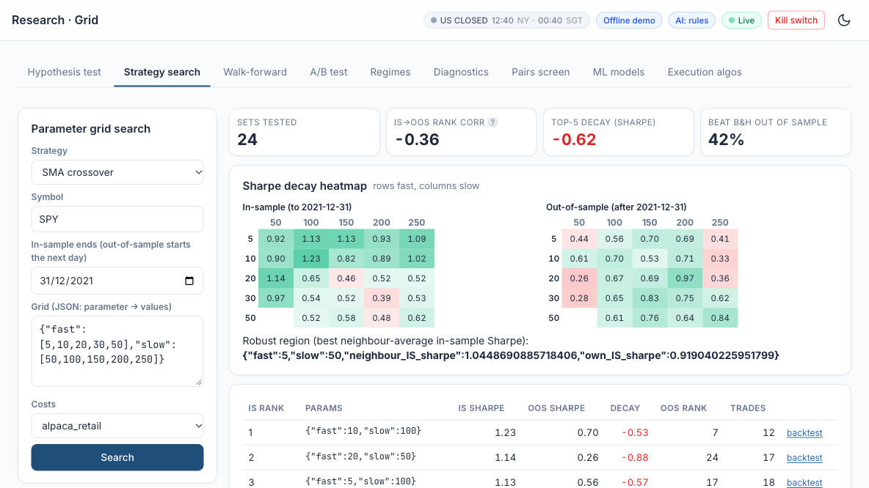
LAB 10 · SIMULATOR
Lab 10 — In the Trading Simulator
Course Labs > Lab 10 at http://localhost:8000 - Research > Grid SPY SMA cross. Offline demo data; connect Alpaca paper keys for live paper trading.
Machine Learning 101 for Financial Trading · FSE-DAT-3019-1.1 · v2.4
© Tertiary Infotech Academy Pte Ltd
162

Slide 163
TOPIC 3 · HANDS-ON LAB
A4 K4 K6
ML-Signal Stage: a Walk-Forward Classifier from Probability to Position
LAB 11
Train logistic regression, random forest and XGBoost walk-forward and trade P(up) > threshold.
WORKFLOW
1
2
3
Simulator: Train the classifiers
▶
Simulator: Backtest an ML strategy
▶
Simulator: Check for leakage
YOU'LL PRODUCE
Duration
20 min
Accuracy / AUC table, feature importance and a net-of-cost backtest of the ML signal.
Machine Learning 101 for Financial Trading · FSE-DAT-3019-1.1 · v2.4
© Tertiary Infotech Academy Pte Ltd
163

Slide 164
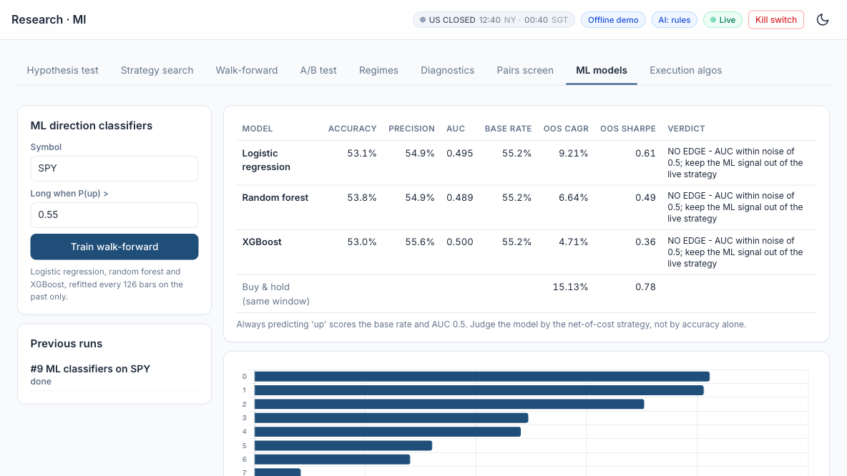
LAB 11 · SIMULATOR
Lab 11 — In the Trading Simulator
Course Labs > Lab 11 at http://localhost:8000 - Research > ML SPY. Offline demo data; connect Alpaca paper keys for live paper trading.
Machine Learning 101 for Financial Trading · FSE-DAT-3019-1.1 · v2.4
© Tertiary Infotech Academy Pte Ltd
164

Slide 165
TOPIC 3 · HANDS-ON LAB
A4 K4 K6
Regime-Filter Stage: PCA and K-Means as a Gate on the Signals
LAB 12
Find market regimes with walk-forward K-means and gate a signal in the high-volatility regime.
WORKFLOW
1
2
Simulator: Analyse regimes
▶
Simulator: Backtest the regime-filtered strategy
YOU'LL PRODUCE
Duration
15 min
PCA explained variance, a regime timeline and gated vs ungated performance.
Machine Learning 101 for Financial Trading · FSE-DAT-3019-1.1 · v2.4
© Tertiary Infotech Academy Pte Ltd
165

Slide 166
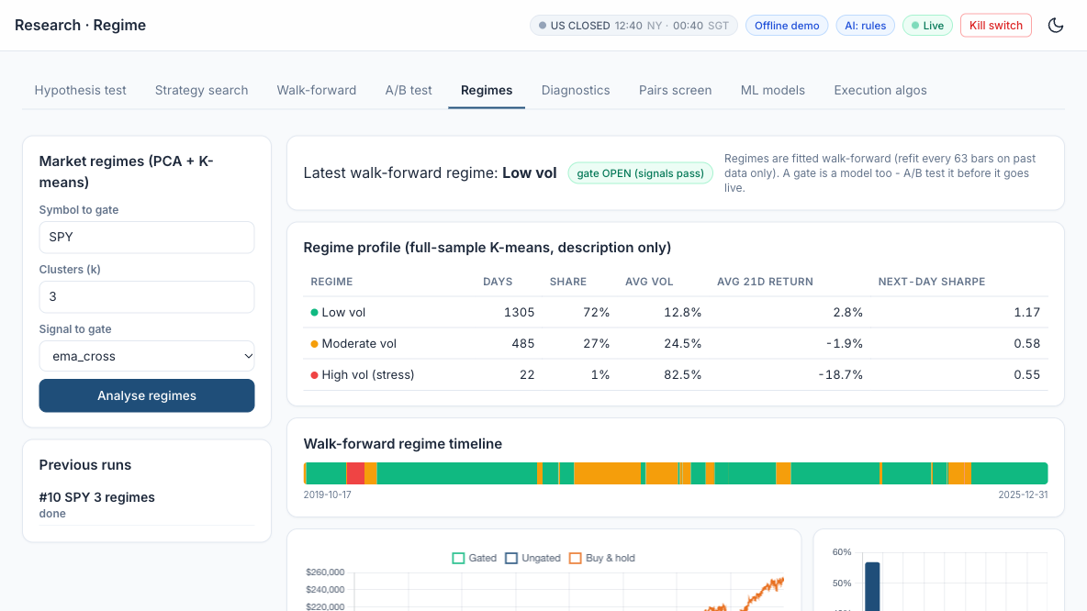
LAB 12 · SIMULATOR
Lab 12 — In the Trading Simulator
Course Labs > Lab 12 at http://localhost:8000 - Research > Regimes SPY. Offline demo data; connect Alpaca paper keys for live paper trading.
Machine Learning 101 for Financial Trading · FSE-DAT-3019-1.1 · v2.4
© Tertiary Infotech Academy Pte Ltd
166

Slide 167
TOPIC 3 · HANDS-ON LAB
A5 K2
A/B-Test Stage: a Statistical Decision before Capital Moves
LAB 13
Decide statistically between two variants before moving capital.
WORKFLOW
1
2
Simulator: Run the A/B test
▶
Simulator: Your own variants
YOU'LL PRODUCE
Duration
15 min
Welch and paired t-tests, a bootstrap Sharpe CI and a decision with a multiple-testing caution.
Machine Learning 101 for Financial Trading · FSE-DAT-3019-1.1 · v2.4
© Tertiary Infotech Academy Pte Ltd
167

Slide 168
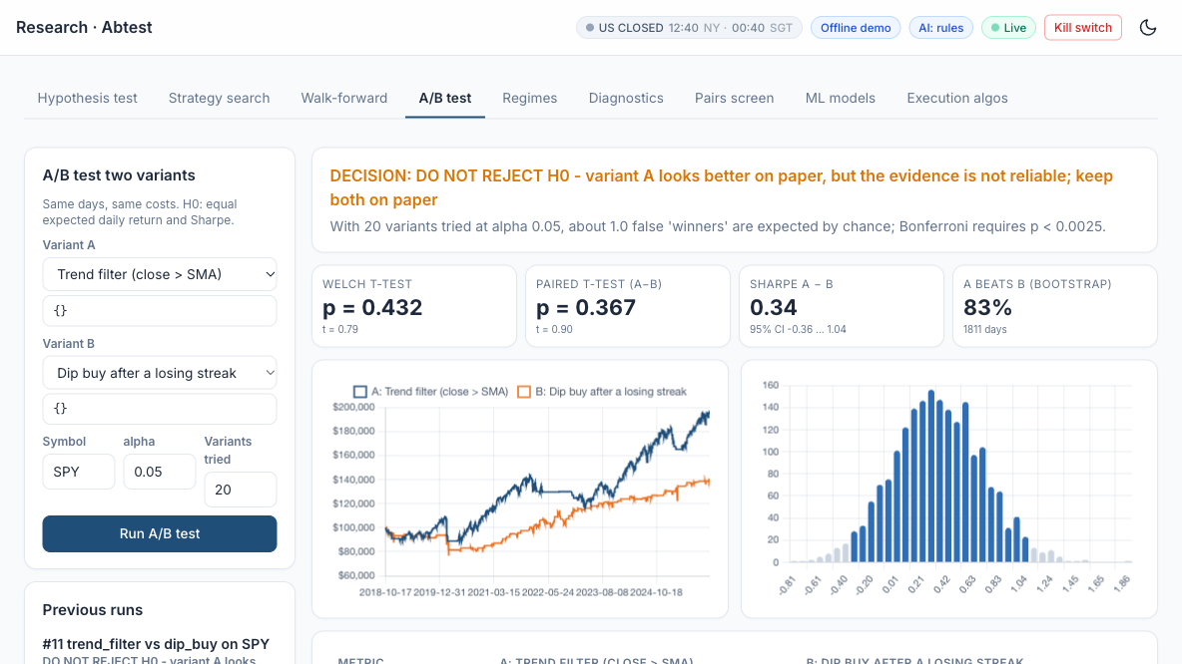
LAB 13 · SIMULATOR
Lab 13 — In the Trading Simulator
Course Labs > Lab 13 at http://localhost:8000 - Research > A/B trend_filter vs dip_buy. Offline demo data; connect Alpaca paper keys for live paper trading.
Machine Learning 101 for Financial Trading · FSE-DAT-3019-1.1 · v2.4
© Tertiary Infotech Academy Pte Ltd
168

Slide 169
TOPIC 3 · HANDS-ON LAB
A4 K6
Pairs Stage: a Hedged, Market-Neutral Statistical-Arbitrage Sleeve
LAB 14
Screen pairs for cointegration and backtest a market-neutral KO/PEP spread.
WORKFLOW
1
2
Simulator: Screen the pairs
▶
Simulator: Backtest KO/PEP
YOU'LL PRODUCE
Duration
20 min
An Engle-Granger screen and a pairs backtest with beta near zero.
Machine Learning 101 for Financial Trading · FSE-DAT-3019-1.1 · v2.4
© Tertiary Infotech Academy Pte Ltd
169

Slide 170
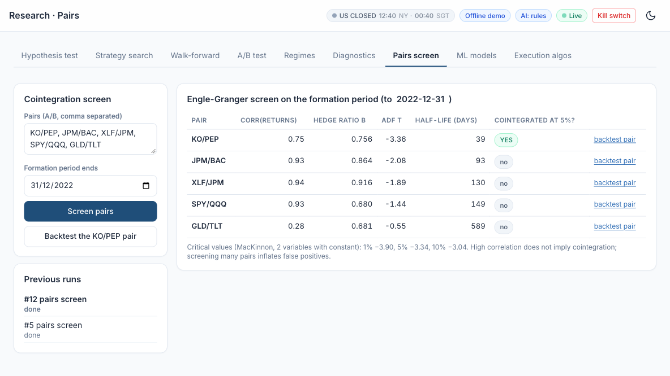
LAB 14 · SIMULATOR
Lab 14 — In the Trading Simulator
Course Labs > Lab 14 at http://localhost:8000 - Research > Pairs screen. Offline demo data; connect Alpaca paper keys for live paper trading.
Machine Learning 101 for Financial Trading · FSE-DAT-3019-1.1 · v2.4
© Tertiary Infotech Academy Pte Ltd
170

Slide 171
TOPIC 3 · WHAT YOU COVERED
A4 A5 K2 K4 K6
Topic 3 Recap
1
A4
Conduct statistical modelling of data to derive patterns and solutions
2
A5
Perform A/B testing based on different hypotheses
3
K2
Types of statistical analyses, data models, algorithms and advanced computational methods
4
K4
Range and application of various types of data models
5
K6
Statistical modelling techniques
Machine Learning 101 for Financial Trading · FSE-DAT-3019-1.1 · v2.4
© Tertiary Infotech Academy Pte Ltd
171

Slide 172
04
TOPIC 4
End-to-End Trading Pipeline
LEARNING OUTCOME
Perform coding and configuration of an automated trading program based on selected models or algorithms, conduct tests on its actions and outcomes, diagnose unintended outcomes, and draw insights from the results to support decisions and report accordingly.
Abilities A7, A8, A9, A10 · Knowledge K7, K8 · Day 2 · Labs 15–20 · Assessed by PP Task 4 and WA Q7, Q8
Machine Learning 101 for Financial Trading · FSE-DAT-3019-1.1 · v2.4
© Tertiary Infotech Academy Pte Ltd
172

Slide 173
TOPIC 4 · A7
A7
Pre-Trade Risk Controls
Position and order limits
Maximum shares, maximum order value per symbol.
Maximum daily loss
Stop trading for the day when breached.
1
2
Market-hours and duplicate checks
Alpaca clock; never resend an open order.
Kill switch
One file or flag halts all trading immediately.
3
4
Machine Learning 101 for Financial Trading · FSE-DAT-3019-1.1 · v2.4
© Tertiary Infotech Academy Pte Ltd
173

Slide 174
TOPIC 4 · K7
K7
Trading Costs You Must Model
Commission
Zero on Alpaca US equities — not on most brokers.
Spread and slippage
Half-spread + slippage on every fill, in bps.
1
2
Regulatory fees on sells
SEC Section 31 fee and FINRA TAF.
Borrow and impact
Short-borrow costs; your own market impact.
3
4
Machine Learning 101 for Financial Trading · FSE-DAT-3019-1.1 · v2.4
© Tertiary Infotech Academy Pte Ltd
174

Slide 175

TOPIC 4 · A8, K8
A8 K8
Historical Data: Backtest, Tune, Then Forward Test
BACKTEST ON HISTORY
Replay the strategy's rules over past prices - next-bar fills, trading costs - to see how it would have performed.
TUNE HYPERPARAMETERS (IN-SAMPLE)
Search the settings (MA lengths, RSI levels, model parameters) on the OLDER history only, by grid search or walk-forward.
CONFIRM OUT-OF-SAMPLE
Backtest the tuned settings ONCE on later history the search never saw. A big drop from in-sample = overfitting.
FORWARD TEST (PAPER)
Run the tuned strategy on NEW data as it arrives - paper orders, real fills and risk checks - before any capital.
Machine Learning 101 for Financial Trading · FSE-DAT-3019-1.1 · v2.4
© Tertiary Infotech Academy Pte Ltd
175

Slide 176
TOPIC 4 · A8
A8
From Historical Data to a Forward-Tested Strategy
The same rule moves through four tests; each uses data the previous step never touched.
1
2
3
4
5
▶
▶
▶
▶
Historical data (2018-2025)
Tune in-sample (2018-2021)
Backtest once out-of-sample (2022-2024)
Forward test on paper (2025 onward)
Go-live decision
Tuning on the test period, or re-tuning after seeing out-of-sample results, turns the test into more tuning - the result will look better than reality (Labs 10, 15, 16).
Machine Learning 101 for Financial Trading · FSE-DAT-3019-1.1 · v2.4
© Tertiary Infotech Academy Pte Ltd
176

Slide 177
TOPIC 4 · K8
K8
Potential Reasons for Unintended Outcomes
Overfitting and data snooping
Great in-sample, collapses out of sample.
Look-ahead and survivorship bias
Same-bar fills; only today's survivors.
1
2
Cost and execution drag
Live returns trail the backtest by turnover × cost.
Regime change, data and code errors
Drift, bad splits, time zones, duplicate orders.
3
4
Machine Learning 101 for Financial Trading · FSE-DAT-3019-1.1 · v2.4
© Tertiary Infotech Academy Pte Ltd
177

Slide 178
TOPIC 4 · A10
A10
What Goes on a Tearsheet
Equity versus benchmark
Growth of USD 100,000, strategy and buy-and-hold.
Drawdown and rolling Sharpe
Depth, length and stability of the edge.
1
2
Monthly returns heatmap
When did it make — and lose — money?
Metrics and cost table
Gross versus net; backtest versus forward.
3
4
Machine Learning 101 for Financial Trading · FSE-DAT-3019-1.1 · v2.4
© Tertiary Infotech Academy Pte Ltd
178

Slide 179
TOPIC 4 · A7
A7
The End-to-End Algorithmic Trading Pipeline
1
2
3
4
5
6
7
8
▶
▶
▶
▶
▶
▶
▶
Strategy search
Data ingestion
Signal
Backtest with costs
Risk checks
Order execution
Forward test
Monitor and report
Configuration — symbols, parameters, limits, keys — lives outside the code.
Machine Learning 101 for Financial Trading · FSE-DAT-3019-1.1 · v2.4
© Tertiary Infotech Academy Pte Ltd
179

Slide 180
TOPIC 4 · A8
A8
The Automated Paper-Trading Bot Loop
One cycle per closed bar.
1
2
3
4
5
6
7
▶
▶
▶
▶
▶
▶
Bar closes
Fetch latest bars
Compute signal
Run risk checks
Target vs actual position
Submit order; read status
Log and sleep
Every cycle writes to the trade log — the evidence for performance and audit.
Machine Learning 101 for Financial Trading · FSE-DAT-3019-1.1 · v2.4
© Tertiary Infotech Academy Pte Ltd
180

Slide 181
TOPIC 4 · A7
A7
TradingView Alert to Alpaca Order
Webhook-driven execution.
1
2
3
4
5
6
▶
▶
▶
▶
▶
Pine strategy fires alert
TradingView POSTs JSON
Your server checks secret
Risk checks
alpaca-py submits paper order
Log and respond 200
Webhook alerts need a paid TradingView plan and a public URL (e.g. a tunnel).
Machine Learning 101 for Financial Trading · FSE-DAT-3019-1.1 · v2.4
© Tertiary Infotech Academy Pte Ltd
181

Slide 182
TOPIC 4 · A9
A9
Diagnosing an Unintended Outcome
1
2
3
4
5
▶
▶
▶
▶
Reproduce the result
Isolate the first divergent step
Data · signal · order · fill?
Compare with a known-good run
Fix and re-test
Read the first failure, not the last — everything after it is a consequence.
Machine Learning 101 for Financial Trading · FSE-DAT-3019-1.1 · v2.4
© Tertiary Infotech Academy Pte Ltd
182

Slide 183
Lunch Break
1 hour · see you at 13:30
Machine Learning 101 for Financial Trading · FSE-DAT-3019-1.1 · v2.4
© Tertiary Infotech Academy Pte Ltd
183

Slide 184
TOPIC 4 · HANDS-ON LAB
A7 A8 K7
Backtest-Engine Stage: Cost Models, Execution Timing and Break-Even
LAB 15
Run the same strategy under four cost models and find its break-even cost.
WORKFLOW
1
2
3
Simulator: Zero vs Alpaca vs high-cost
▶
Simulator: Break-even and execution timing
▶
Simulator: Stops and sizing
YOU'LL PRODUCE
Duration
25 min
Gross vs net CAGR, a cost breakdown and the break-even bps.
Machine Learning 101 for Financial Trading · FSE-DAT-3019-1.1 · v2.4
© Tertiary Infotech Academy Pte Ltd
184

Slide 185
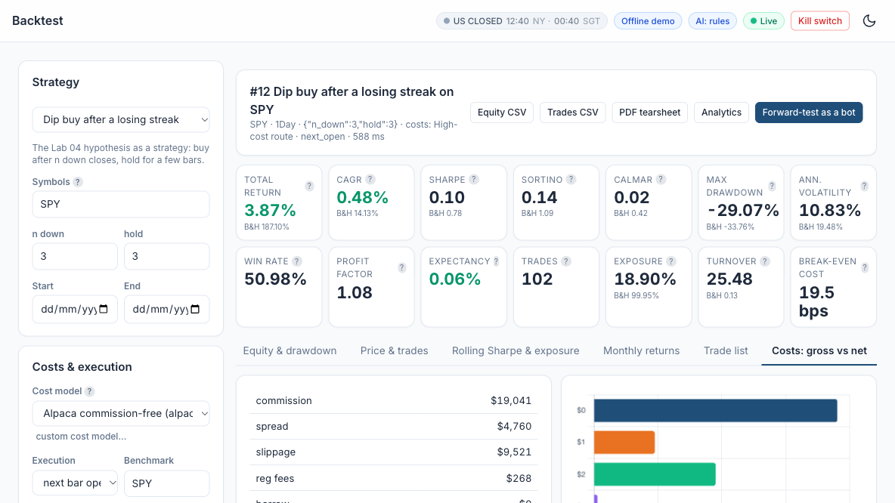
LAB 15 · SIMULATOR
Lab 15 — In the Trading Simulator
Course Labs > Lab 15 at http://localhost:8000 - Backtest SPY dip-buy, high-cost route. Offline demo data; connect Alpaca paper keys for live paper trading.
Machine Learning 101 for Financial Trading · FSE-DAT-3019-1.1 · v2.4
© Tertiary Infotech Academy Pte Ltd
185

Slide 186
TOPIC 4 · HANDS-ON LAB
A7 A8 K7
Automation Stage: a Scheduled, Risk-Checked Forward Test and Live Paper Trading
LAB 16
Create a bot, run it on a schedule, watch orders, positions and P&L live, and halt it with the kill switch.
WORKFLOW
1
2
3
4
Simulator: Create the bot
▶
Simulator: Start it and watch
▶
Simulator: Kill switch
▶
Simulator: Backtest vs forward
YOU'LL PRODUCE
Duration
25 min
A bot equity curve, a blotter of its orders, a backtest-vs-forward comparison and a tested kill switch.
Machine Learning 101 for Financial Trading · FSE-DAT-3019-1.1 · v2.4
© Tertiary Infotech Academy Pte Ltd
186

Slide 187
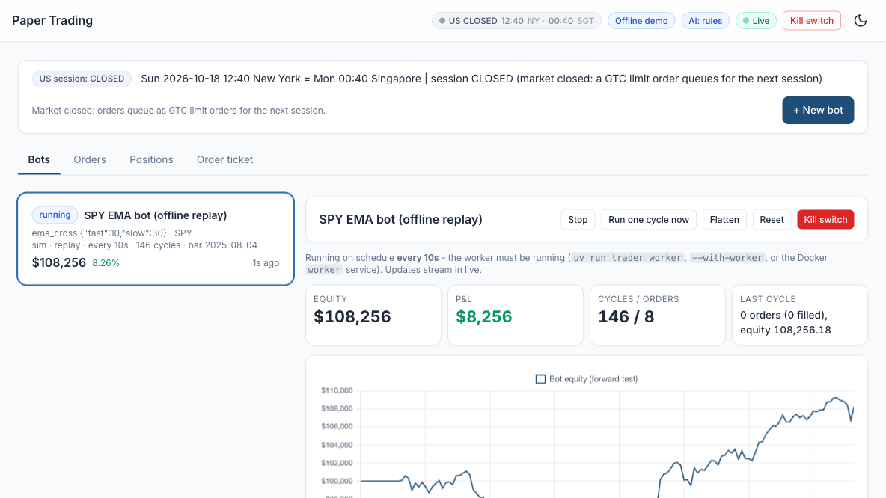
LAB 16 · SIMULATOR
Lab 16 — In the Trading Simulator
Course Labs > Lab 16 at http://localhost:8000 - Paper Trading > New bot (EMA cross). Offline demo data; connect Alpaca paper keys for live paper trading.
Machine Learning 101 for Financial Trading · FSE-DAT-3019-1.1 · v2.4
© Tertiary Infotech Academy Pte Ltd
187

Slide 188
TOPIC 4 · HANDS-ON LAB
A7 K5 K7
Event-Driven Automation: TradingView Webhook to Signal, Risk and Execution
LAB 17
Send TradingView alerts to the app's webhook and see them pass validation, signal confirmation and risk into paper orders.
WORKFLOW
1
2
3
Simulator: Copy the alert template
▶
Simulator: Run the self-test
▶
Simulator: Real alerts (paid TradingView plan)
YOU'LL PRODUCE
Duration
20 min
7 simulated alerts handled as expected and the audit log.
Machine Learning 101 for Financial Trading · FSE-DAT-3019-1.1 · v2.4
© Tertiary Infotech Academy Pte Ltd
188

Slide 189
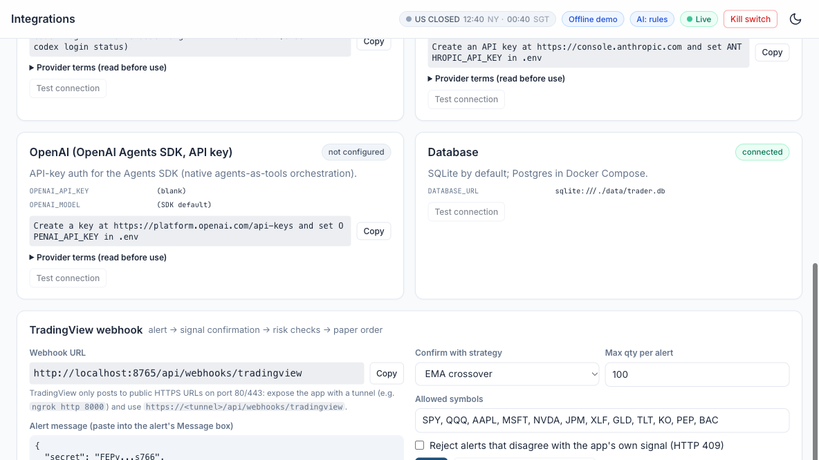
LAB 17 · SIMULATOR
Lab 17 — In the Trading Simulator
Course Labs > Lab 17 at http://localhost:8000 - Integrations > TradingView webhook. Offline demo data; connect Alpaca paper keys for live paper trading.
Machine Learning 101 for Financial Trading · FSE-DAT-3019-1.1 · v2.4
© Tertiary Infotech Academy Pte Ltd
189

Slide 190
TOPIC 4 · HANDS-ON LAB
A9 K8
Diagnostics Stage: Automated Bias Checks before Go-Live
LAB 18
Run the automated diagnostics on a deliberately biased strategy, fix it, and re-run.
WORKFLOW
1
2
3
Simulator: Diagnose the biased exhibit
▶
Simulator: Fix it in the Strategy Builder
▶
Simulator: Re-run diagnostics
YOU'LL PRODUCE
Duration
20 min
A FAIL on the biased exhibit, a PASS / WARN table for the fixed version and a verdict.
Machine Learning 101 for Financial Trading · FSE-DAT-3019-1.1 · v2.4
© Tertiary Infotech Academy Pte Ltd
190

Slide 191
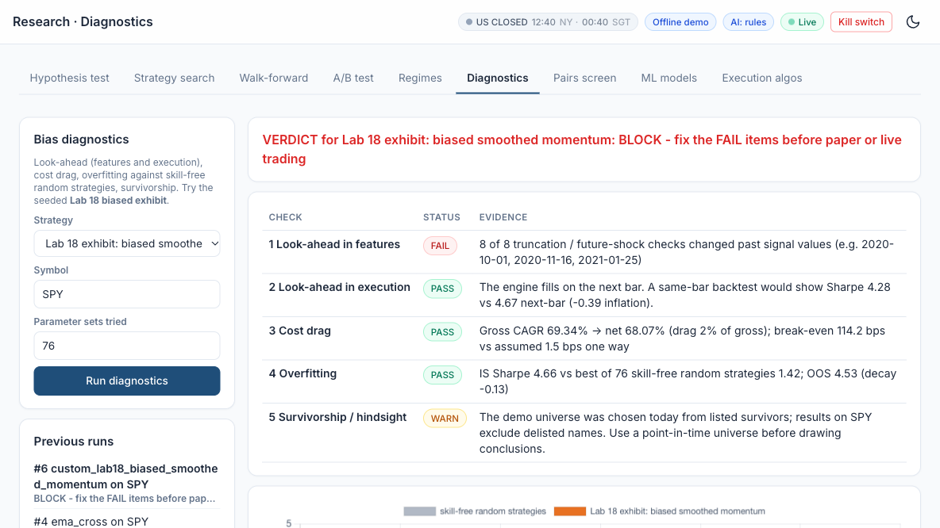
LAB 18 · SIMULATOR
Lab 18 — In the Trading Simulator
Course Labs > Lab 18 at http://localhost:8000 - Research > Diagnostics (Lab 18 exhibit). Offline demo data; connect Alpaca paper keys for live paper trading.
Machine Learning 101 for Financial Trading · FSE-DAT-3019-1.1 · v2.4
© Tertiary Infotech Academy Pte Ltd
191

Slide 192
TOPIC 4 · HANDS-ON LAB
A8 A10
Monitoring and Reporting Stage: Automated Tearsheet and Backtest-vs-Forward Report
LAB 19
Produce a one-page tearsheet and explain the gap between backtest and forward test.
WORKFLOW
1
2
3
Simulator: Export the tearsheet
▶
Simulator: Backtest vs forward
▶
Simulator: Draw insights
YOU'LL PRODUCE
Duration
25 min
A PDF tearsheet and a written explanation of the backtest-vs-forward differences.
Machine Learning 101 for Financial Trading · FSE-DAT-3019-1.1 · v2.4
© Tertiary Infotech Academy Pte Ltd
192

Slide 193
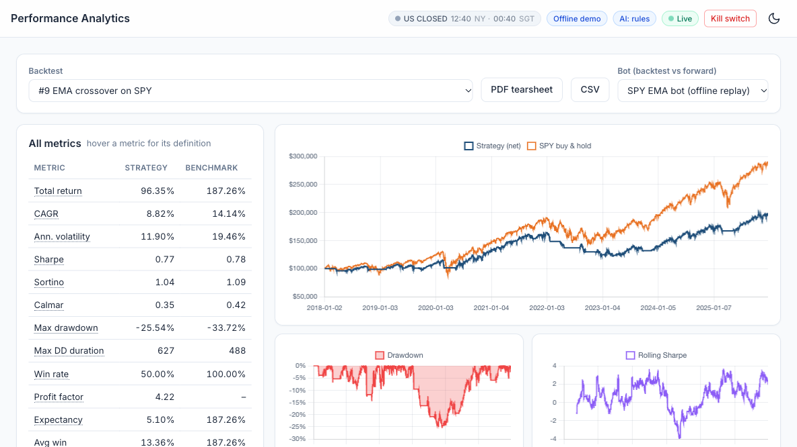
LAB 19 · SIMULATOR
Lab 19 — In the Trading Simulator
Course Labs > Lab 19 at http://localhost:8000 - Analytics > PDF tearsheet. Offline demo data; connect Alpaca paper keys for live paper trading.
Machine Learning 101 for Financial Trading · FSE-DAT-3019-1.1 · v2.4
© Tertiary Infotech Academy Pte Ltd
193

Slide 194
TOPIC 4 · HANDS-ON LAB
A7 A10 K1
Capstone: One Command Runs the Pipeline End to End, with an Agentic Layer and Human Approval
LAB 20
Run the whole pipeline end to end, get a human-approved proposal from the multi-agent desk, switch on the always-on agent, and create, backtest and forward-test your own strategy (from a template or written for you by AI).
WORKFLOW
1
2
3
4
5
Simulator: Run the multi-agent desk
▶
Simulator: Human approval
▶
Simulator: Always-on agent
▶
Simulator: Create your own strategy
▶
Simulator: Backtest, diagnose and forward-test it
YOU'LL PRODUCE
Duration
20 min
A Pipeline Map with every stage green, an approved agent proposal with its decision trace, and your custom strategy trading on paper.
Machine Learning 101 for Financial Trading · FSE-DAT-3019-1.1 · v2.4
© Tertiary Infotech Academy Pte Ltd
194

Slide 195
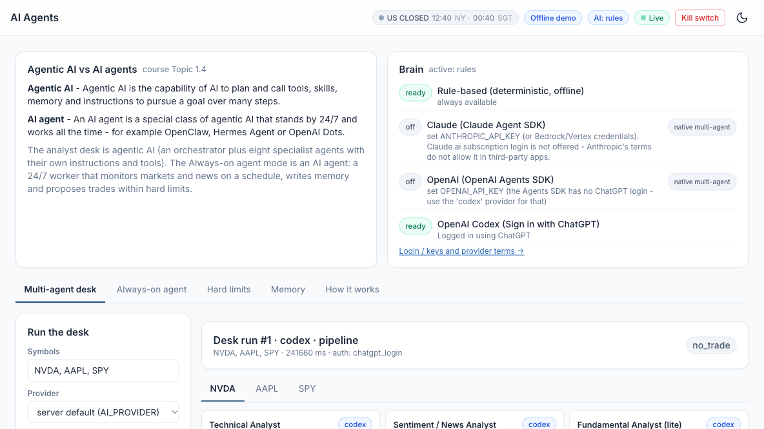
LAB 20 · SIMULATOR
Lab 20 — In the Trading Simulator
Course Labs > Lab 20 at http://localhost:8000 - AI Agents > desk. Offline demo data; connect Alpaca paper keys for live paper trading.
Machine Learning 101 for Financial Trading · FSE-DAT-3019-1.1 · v2.4
© Tertiary Infotech Academy Pte Ltd
195

Slide 196
TOPIC 4 · WHAT YOU COVERED
A7 A8 A9 A10 K7 K8
Topic 4 Recap
1
A7
Perform coding and configuration of software agents or programs based on selected models or algorithms
2
A8
Conduct tests on the actions taken and outcomes to assess effectiveness of the models
3
A9
Diagnose unintended outcomes produced by statistical models
4
A10
Draw relevant trends and insights from data analysis to support decisions and report accordingly
5
K7
Coding languages for programming of algorithms and signals
6
K8
Potential reasons for unintended outcomes
Machine Learning 101 for Financial Trading · FSE-DAT-3019-1.1 · v2.4
© Tertiary Infotech Academy Pte Ltd
196

Slide 197
SUMMARY
What You Achieved
Framed testable hypotheses
Instrument, signal, holding period, effect, benchmark.
Built indicators and strategies
Pine Script on TradingView; configured in the Trading Simulator.
1
2
Modelled and A/B-tested
ML classifiers, regimes, Welch's t-test and bootstrap.
Backtested net of costs
Commission, spread, slippage and regulatory fees.
3
4
Forward-tested automatically
A paper-trading bot with risk checks and a trade log.
Diagnosed and reported
Found the bias, fixed it, and wrote the recommendation.
5
✓
Machine Learning 101 for Financial Trading · FSE-DAT-3019-1.1 · v2.4
© Tertiary Infotech Academy Pte Ltd
197

Slide 198
COURSE PORTAL
Courseware & Assessment on the LMS
Everything for the open-book assessment — slides, Learner Guide and submissions — lives on the LMS.
Sign in
Log in with your registered email (OTP or password).
1
T
Download the courseware
Trainer slides, Learner Guide and lab artefacts.
2
Tertiary Infotech Academy
LMS for IBF-STS courses
Mark attendance
Sign in for each session — IBF-STS funding needs 75% attendance.
3
Sign in / OTP
Submit the assessment
Upload your WA answers and PP evidence here.
lms-tms.tertiaryinfotech.com
4
Machine Learning 101 for Financial Trading · FSE-DAT-3019-1.1 · v2.4
© Tertiary Infotech Academy Pte Ltd
198

Slide 199
ASSESSMENT
Assessment — Reminder
Written Assessment
Practical Performance
45 minutes · open book · 9 short-answer questions covering K1 - K9.
75 minutes · open book · 4 tasks (configure and run the provided trading program - no coding), A1 - A10.
Machine Learning 101 for Financial Trading · FSE-DAT-3019-1.1 · v2.4
© Tertiary Infotech Academy Pte Ltd
199

Slide 200
ON ASSESSMENT DAY
Assessment Flow
1
2
3
4
5
▶
▶
▶
▶
Sign the assessment attendance record
Assessor briefing (not assessed)
Sit the WA (45 min) then the PP (75 min) — open book
Submit your answers on the LMS
Sign the Assessment Summary Record
Sign the assessment attendance record BEFORE you begin. Submit on the LMS.
Machine Learning 101 for Financial Trading · FSE-DAT-3019-1.1 · v2.4
© Tertiary Infotech Academy Pte Ltd
200

Slide 201
CLOSING
Before You Leave
Attendance
Make sure every session is signed — 75% is required for IBF-STS funding.
Course feedback
Complete the feedback form on the LMS.
1
2
Keep practising on paper
Your Alpaca paper account, the Trading Simulator and the lab manuals are yours to keep.
Not investment advice
Scenarios are fictitious; trade real money only with proper advice.
3
!
Machine Learning 101 for Financial Trading · FSE-DAT-3019-1.1 · v2.4
© Tertiary Infotech Academy Pte Ltd
201

Slide 202
Thank You
Machine Learning 101 for Financial Trading · FSE-DAT-3019-1.1
Tertiary Infotech Academy Pte Ltd · UEN 201200696W
Machine Learning 101 for Financial Trading · FSE-DAT-3019-1.1 · v2.4
© Tertiary Infotech Academy Pte Ltd
202

